Slide 1
Salesforce + Eloqua
Today & In the Future

Slide 2
MODERATORS
Chris Carney, Paciolan
Andrew Campbell, Paciolan
PRESENTERS
Kent Dubler, JMU

Slide 3
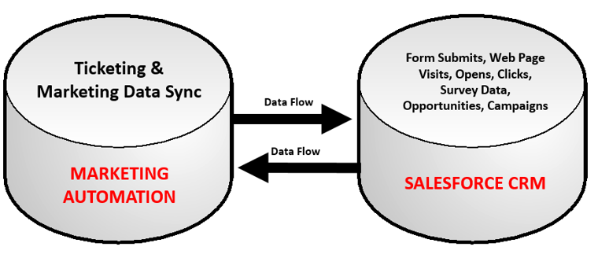
Marketing Automation and Salesforce

Slide 4
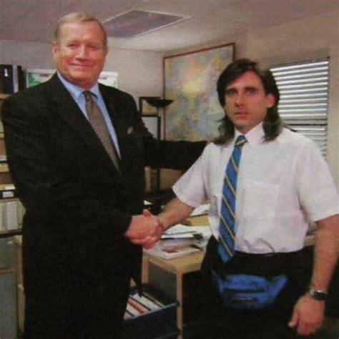
Adobe Campaign
+
Salesforce

Slide 5

Oracle Eloqua
+
Salesforce

Slide 6
THANK YOU!
QUESTIONS?
Please complete the online session evaluation.

Slide 7
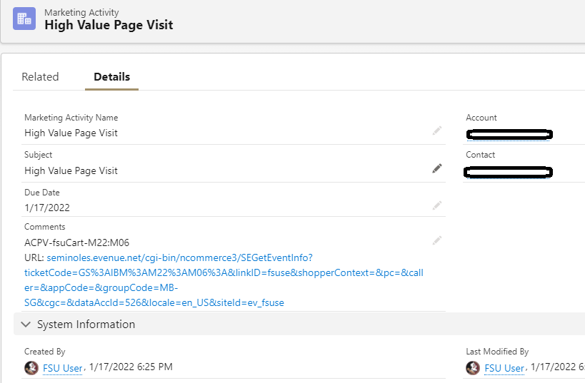
Web Visits
Single Page Tracking
No Engagement Datapoints
X Account, viewed Y Page, on Z Date

Slide 8
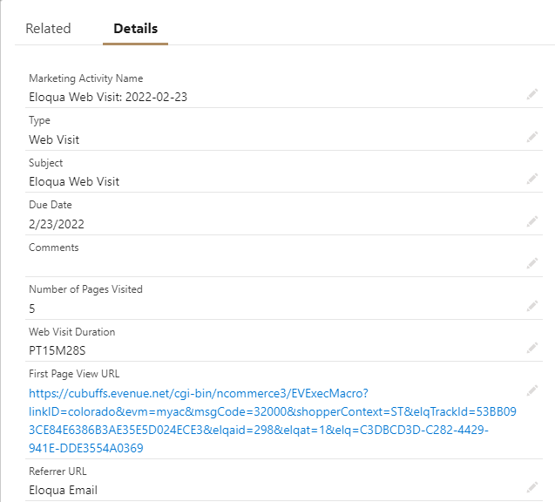
WEB VISITS
Session visit
Additional data points
  Total web pages visited
  Time spent on tracked web sites
  First URL visited
  Referrer

Slide 9
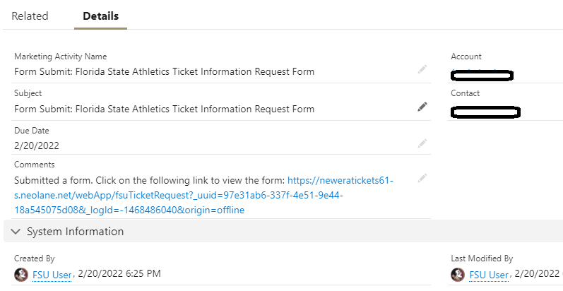
Form Submits
No Raw Form Data into Salesforce
Click into Web Version of Form
No native filtering on Form responses
X Account, filled out Y form, on Z Date

Slide 10
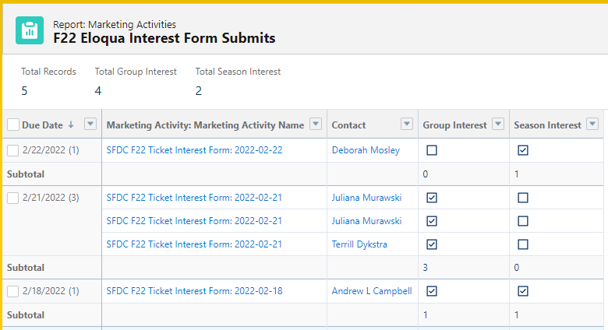
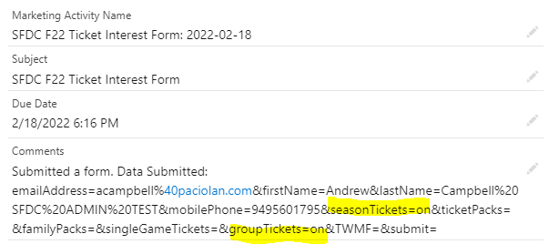
FORM SUBMITS
Less clicks
Raw data from the form pulls through to marketing activity
Comments can be filtered in a report or by using custom fields

Slide 11
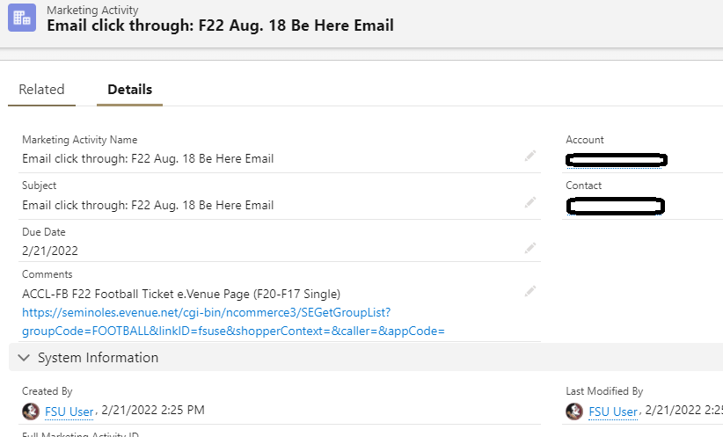
Email Clicks
Required link-labeling to send clicks over
Only clickable link into web page visited
X Account, clicked Y email link, on Z Day

Slide 12
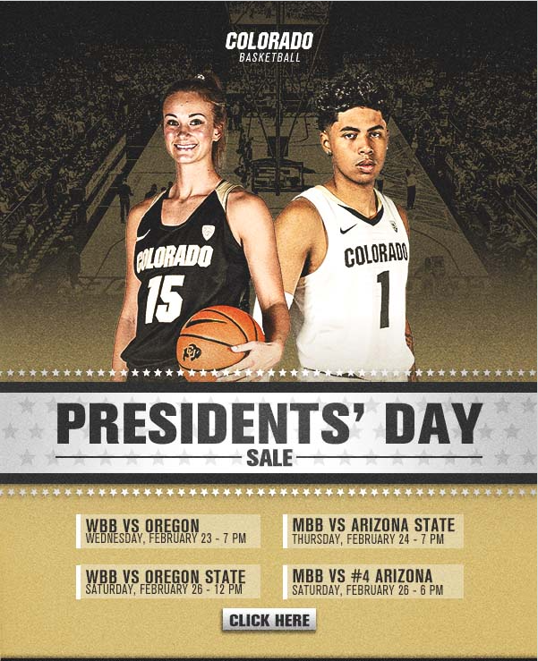
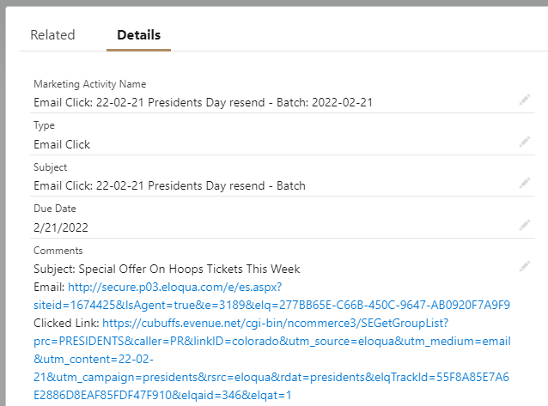
EMAIL CLICKS
No link labeling
Additional data points
  Web version of the email
  Email subject line

Slide 13
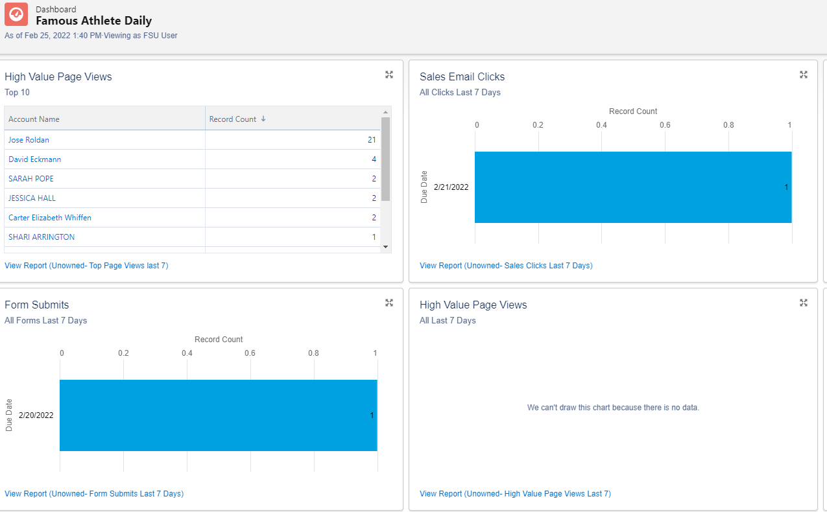
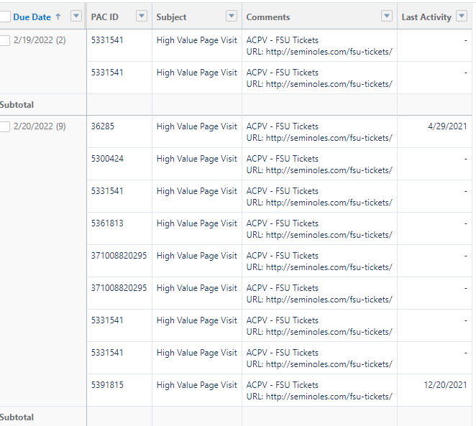
Lead Dashboard

Slide 14
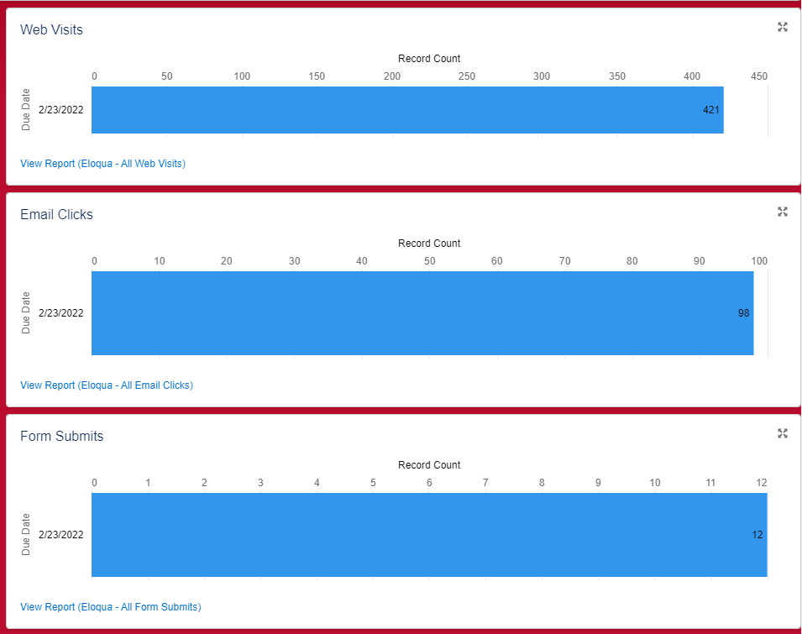
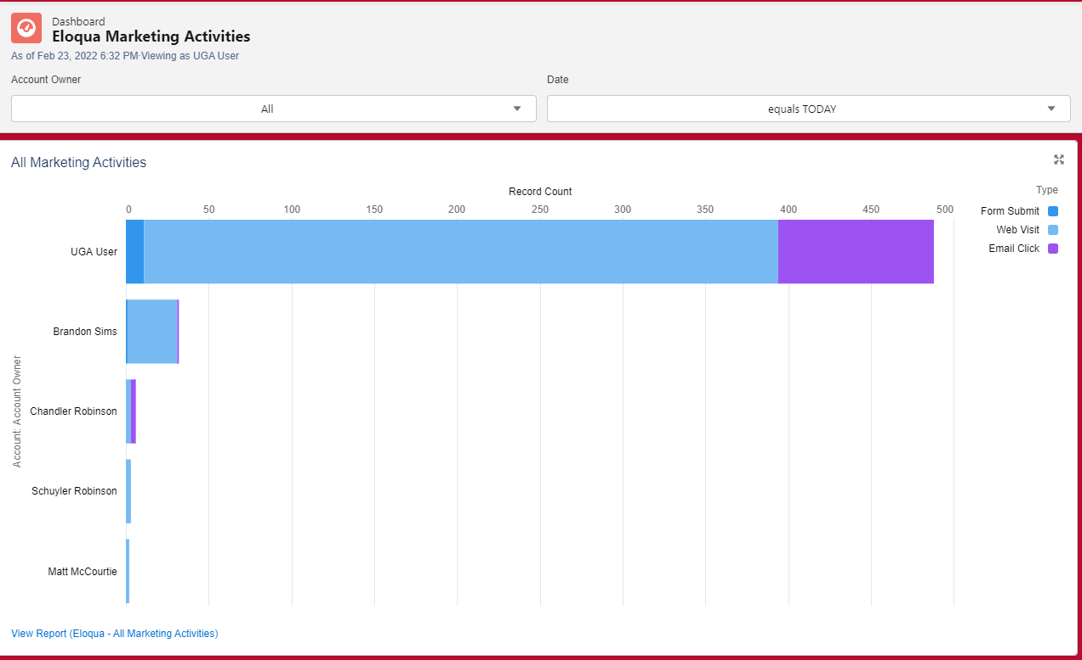
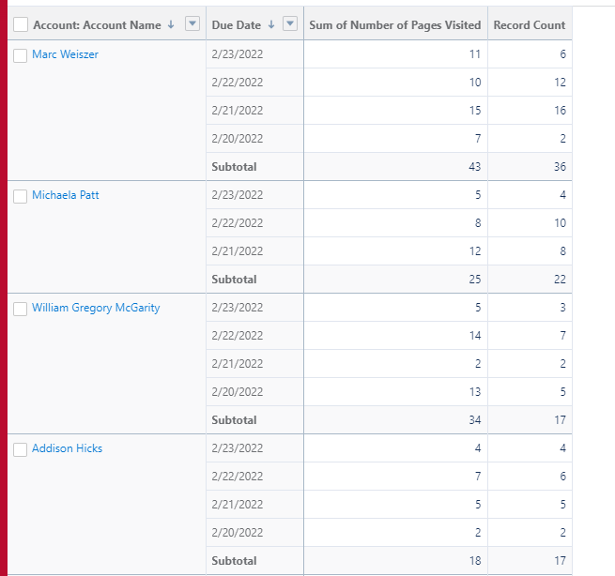
ELOQUA LEAD DASHBOARD

Slide 15
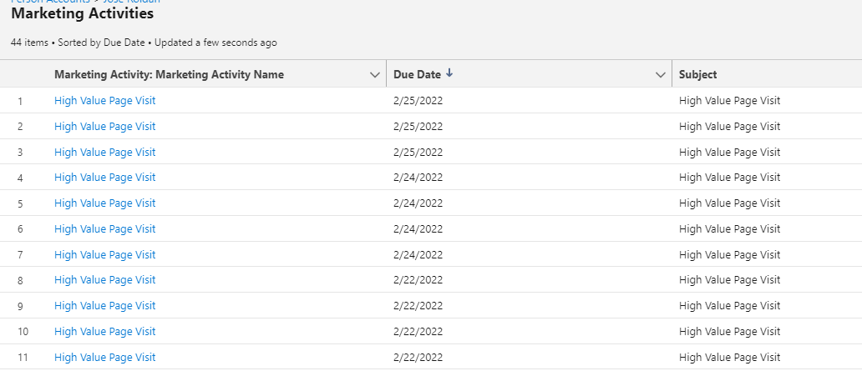
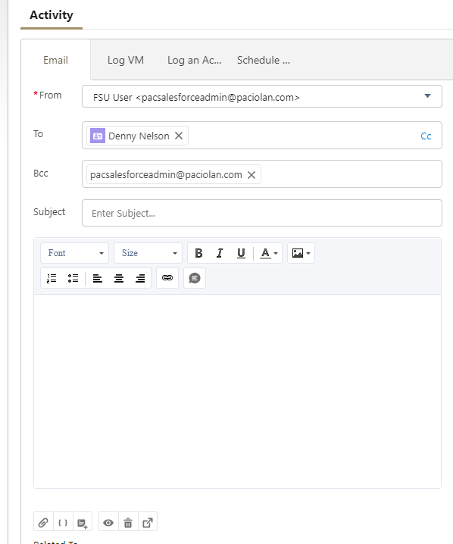
Additional Pain Points
Speed
  Slow
  Every 4-6 hours, or once a day
Full Picture
  No full-view of Marketing engagement
  Limited and specific data points
Sales Rep Email
  No email send through Marketing Automation from Salesforce
  No consideration of Opt-Outs
  Templates

Slide 16
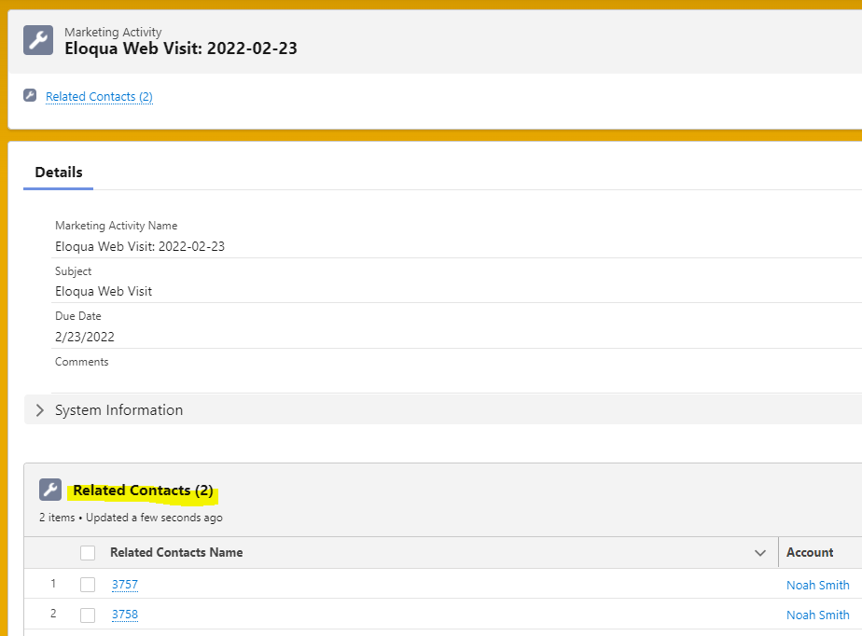
ADDITIONAL ENHANCEMENTS
Speed
  Marketing activities sync to Eloqua every 15 minutes
Duplicate accounts
  Marketing activities match to ALL accounts that match based on email

Slide 17
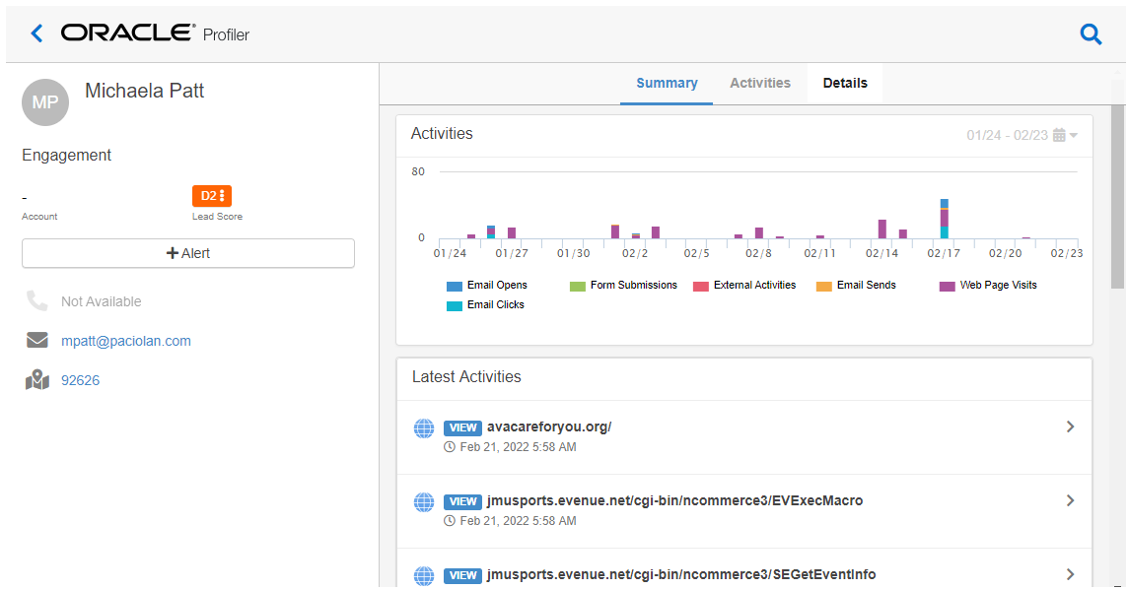
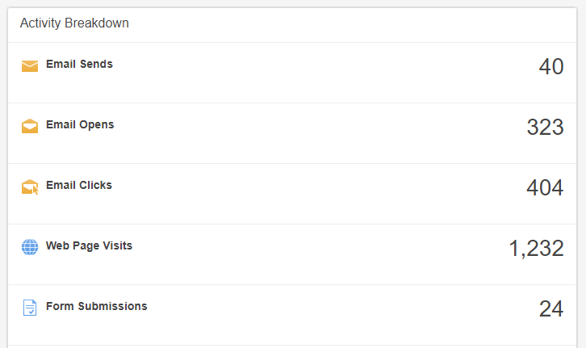
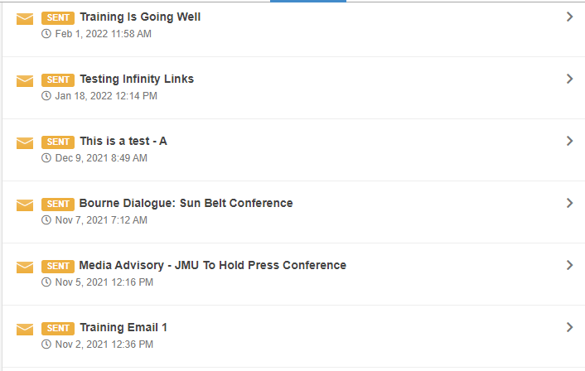
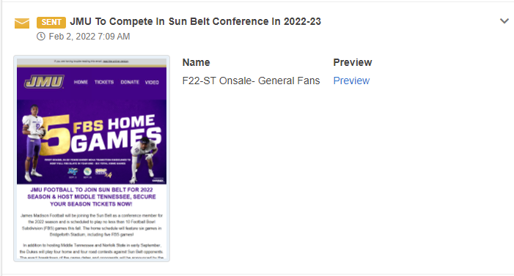
ELOQUA PROFILER

Slide 18
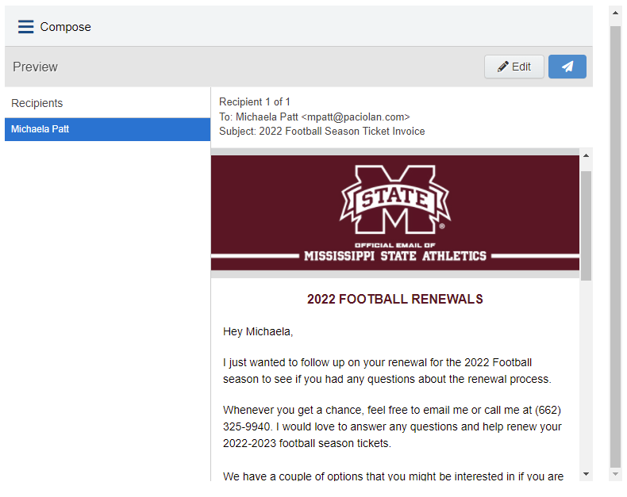
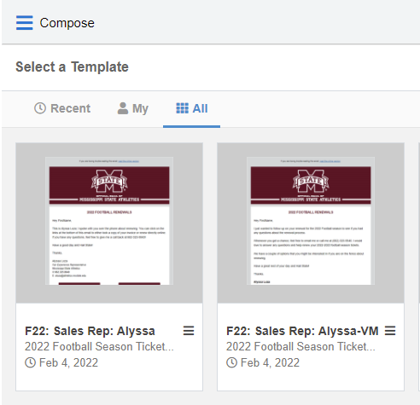
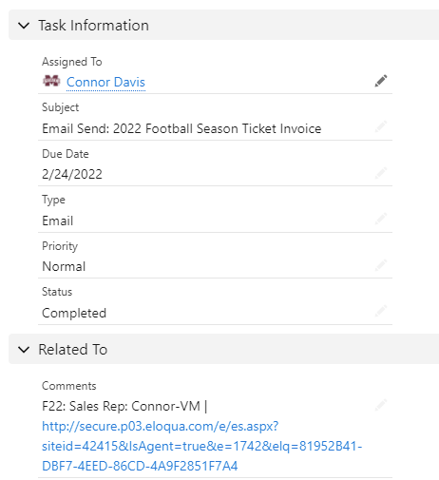
ELOQUA ENGAGE
Send Eloqua emails through Salesforce
Send Eloqua templates built specifically for reps
Resend emails on a one off basis
Log Eloqua email sends as activities

Slide 19
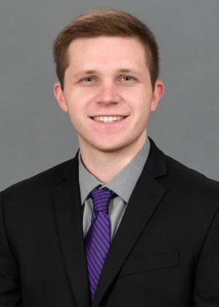
Kent Dubler
James Madison University

Slide 20
JMU – Lead Generation with Forms
Eloqua Form Creation
Website Placement
Form Submission - Salesforce Dashboard
Opportunity/Task Creation

Slide 21
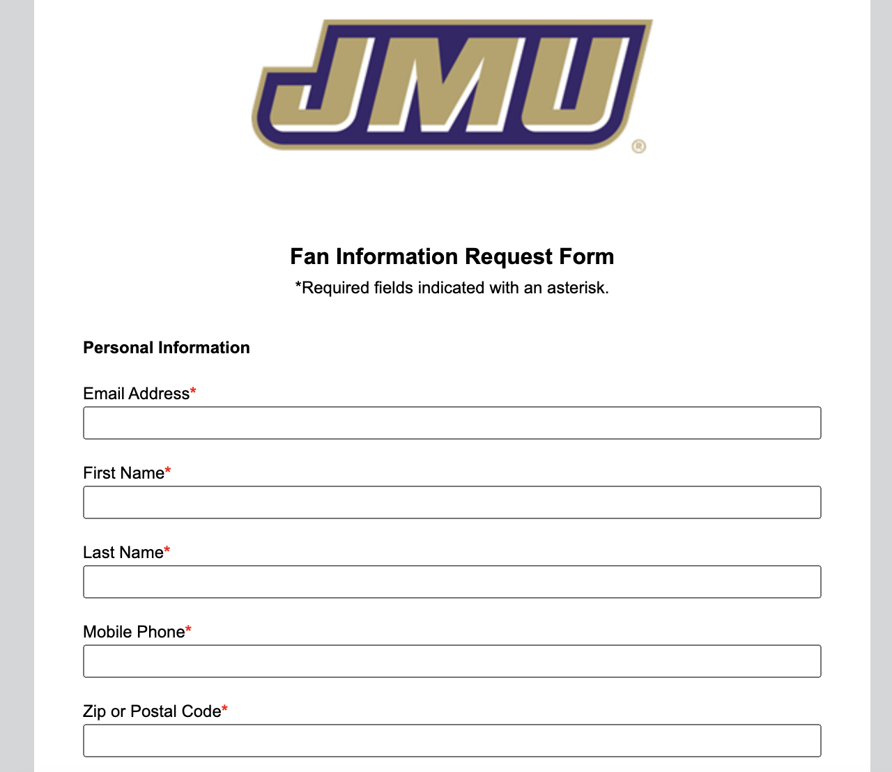
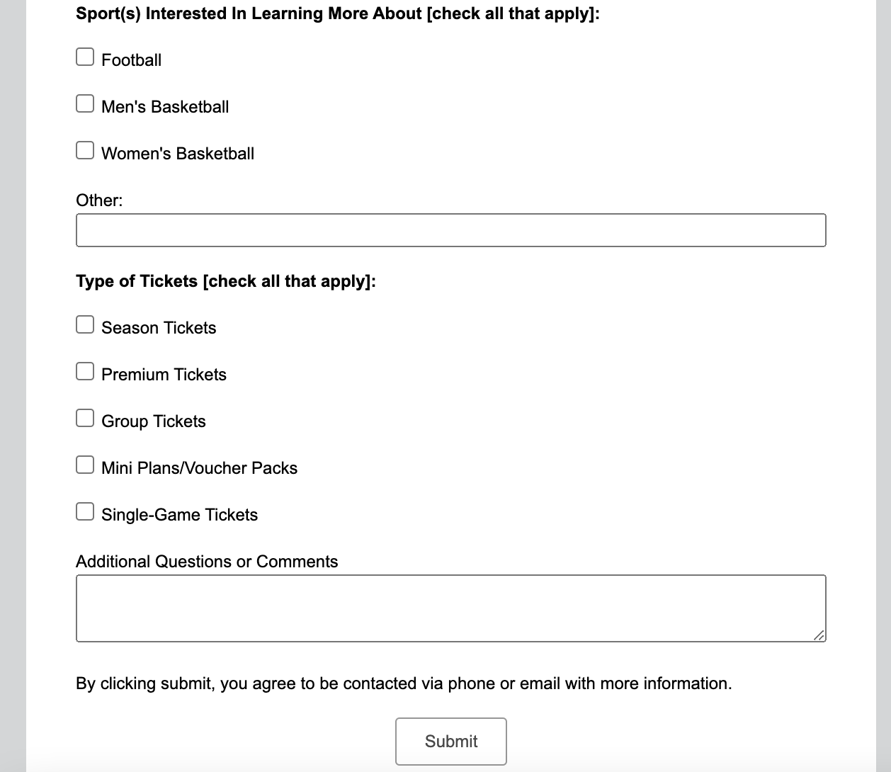
Form Submissions

Slide 22
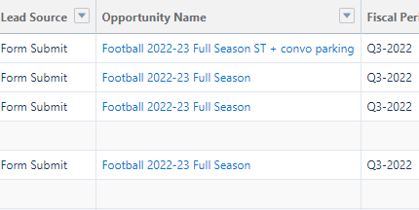
Form to Opportunity

Slide 23
JMU – Eloqua Engage
Where should I send my email from?
Salesforce vs. Eloqua
Tracking customer response (Open/Clicks)

Slide 24
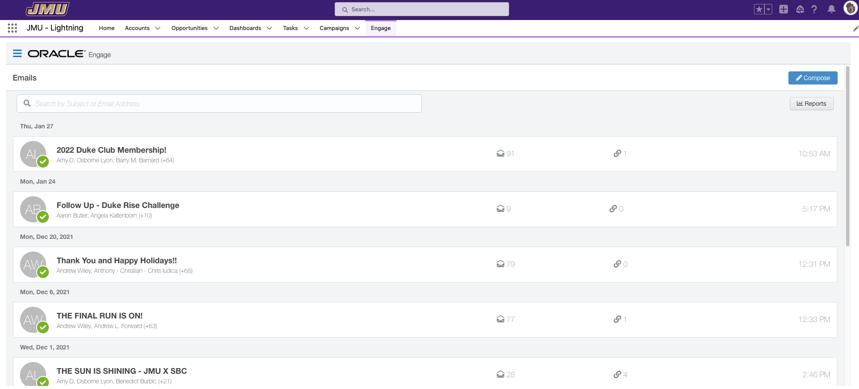
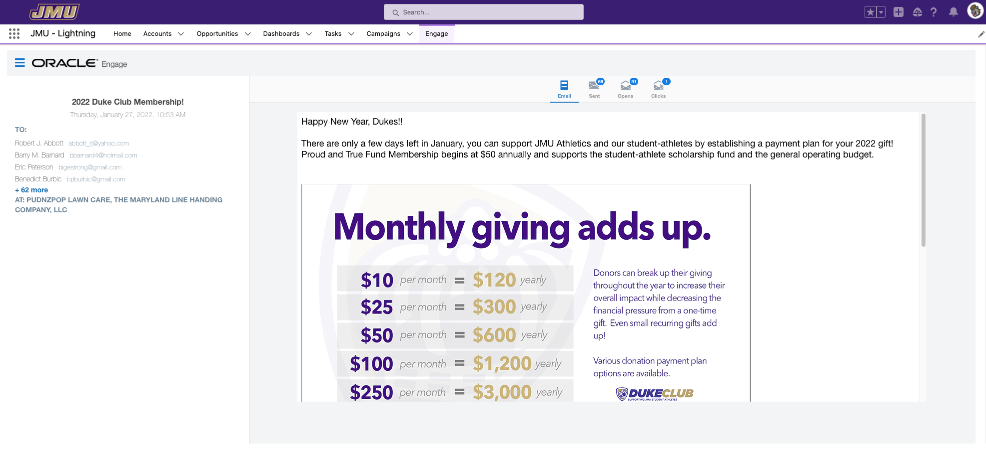
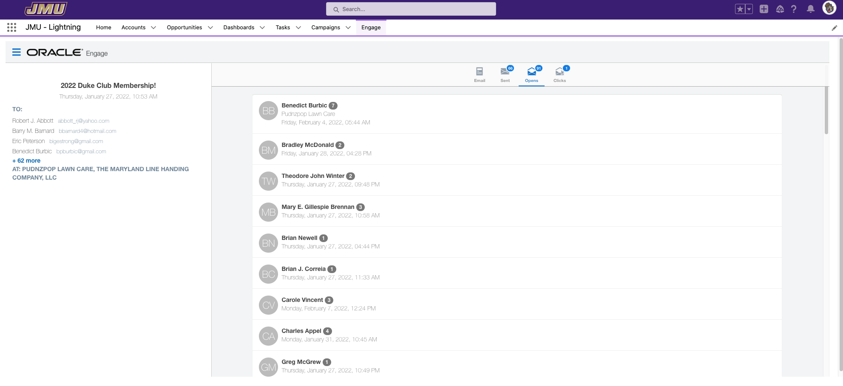
JMU – Eloqua Engage

Slide 25
JMU – Eloqua Profiler
Holistic view of the customer/donor
Review activities and engagements directly in salesforce account profile

Slide 26
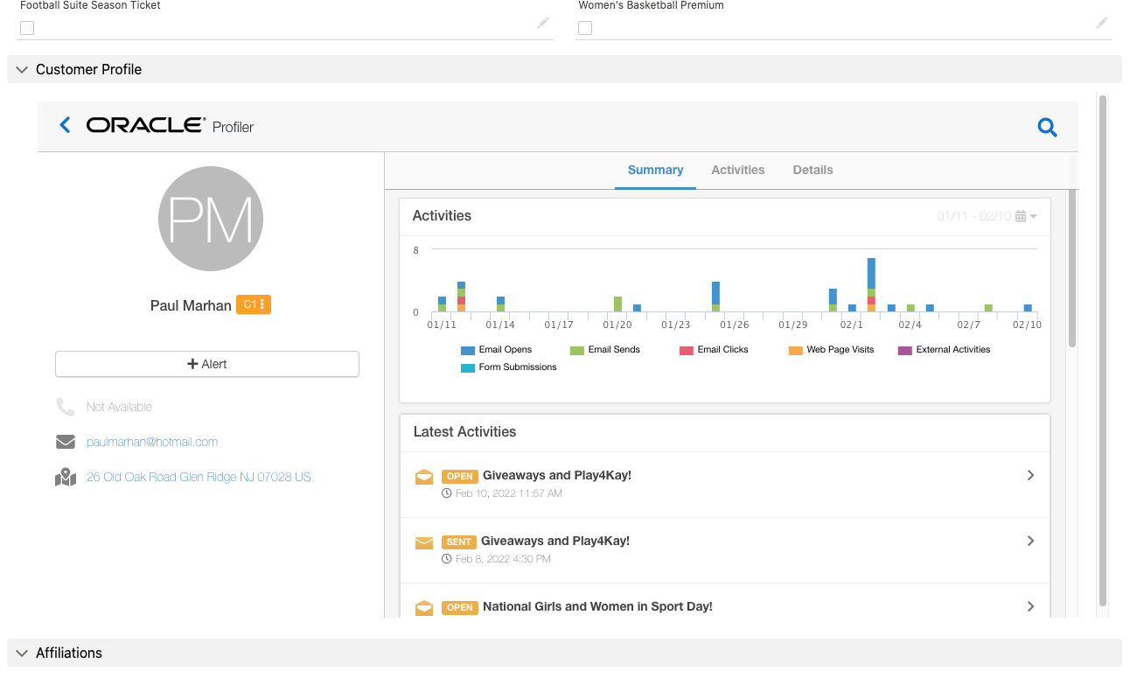
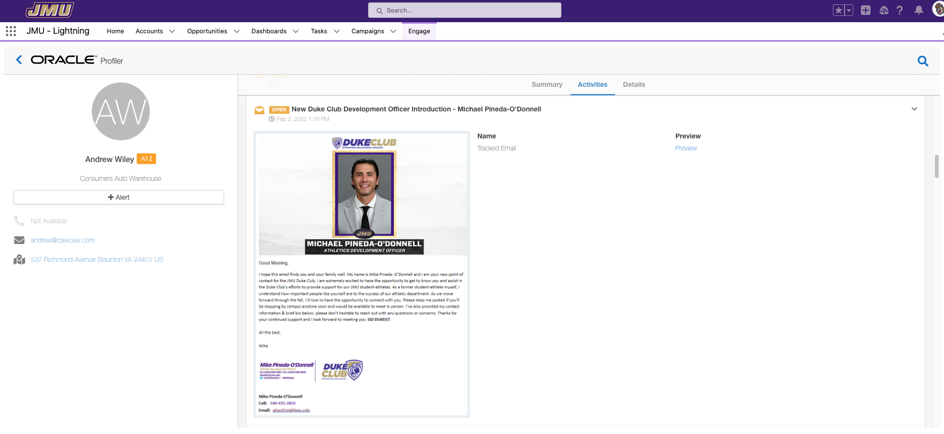
JMU – Eloqua Profiler

Slide 27

EVERYTHING IS CHROME IN THE FUTURE
What’s next?
  Native Eloqua lead scoring
  True customer journeys
  Marketing qualified leads
  Cut through the clutter and ensure your reps are making the right calls at the right time

Slide 28
THANK YOU!
QUESTIONS?
Please complete the online session evaluation.

