Slide 1
Oracle Eloqua Showcase
Paciolan Marketing Automation
today and in the future

Slide 2
PRESENTERS
Mark Campbell , Oracle
Michaela Patt, Paciolan
Kyle Murphy, Paciolan

Slide 3
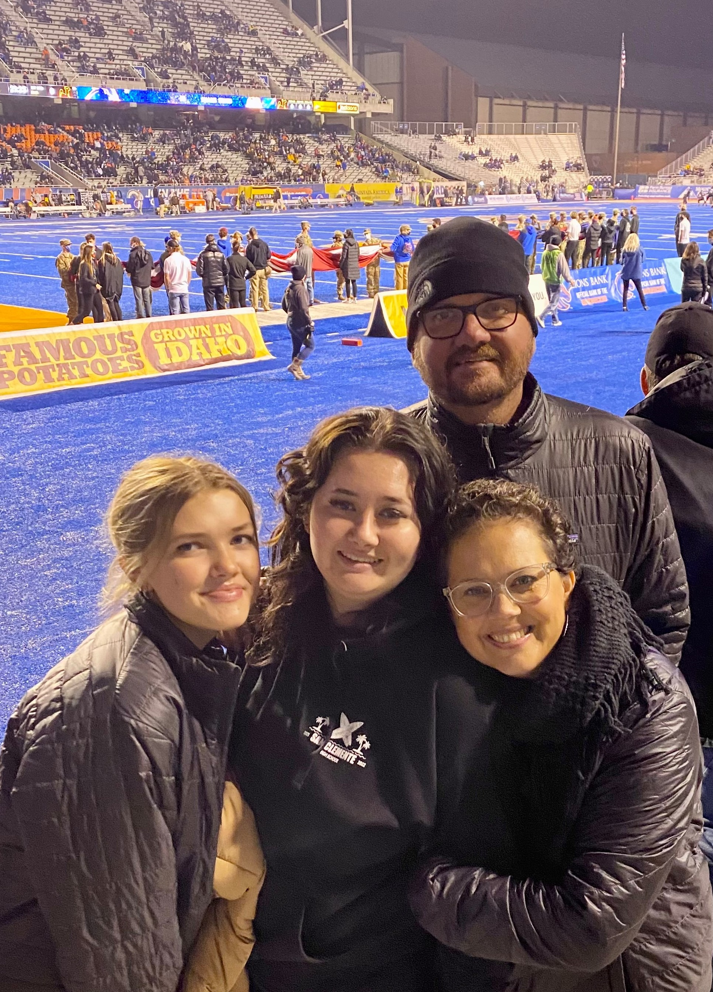
Mark Campbell
Vice President of Sales
Oracle Marketing Cloud

Slide 4


Slide 5
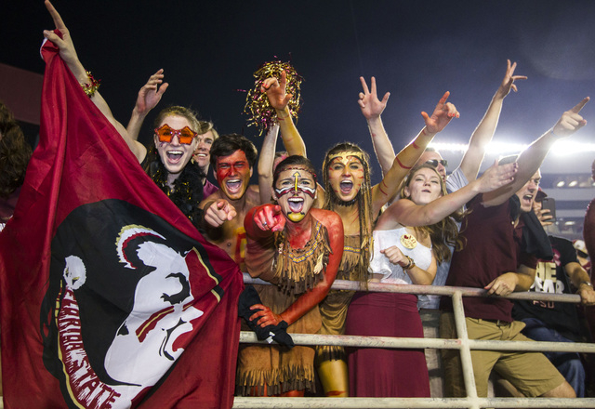
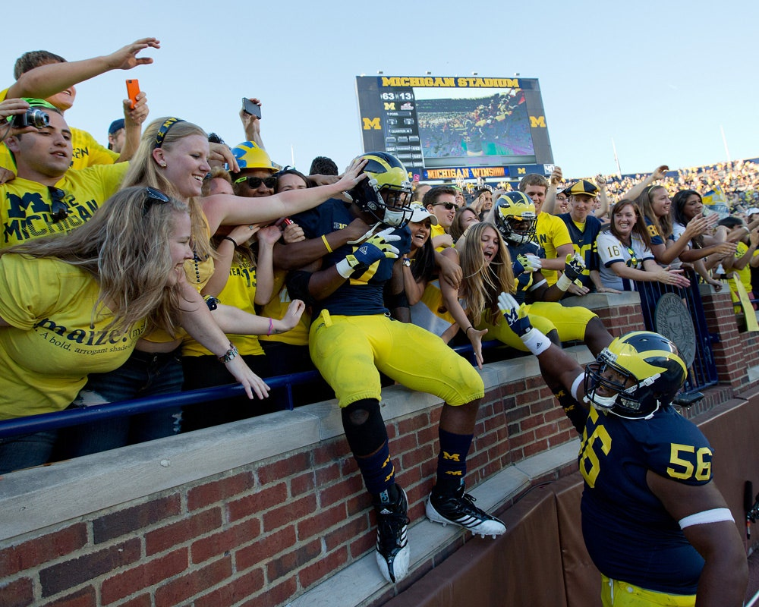
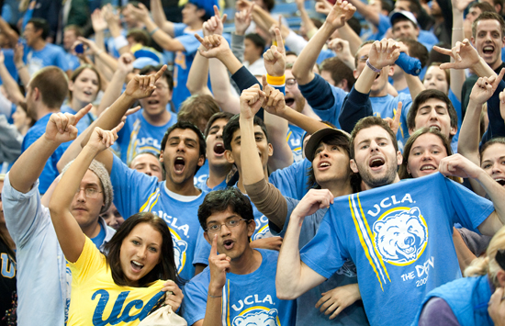
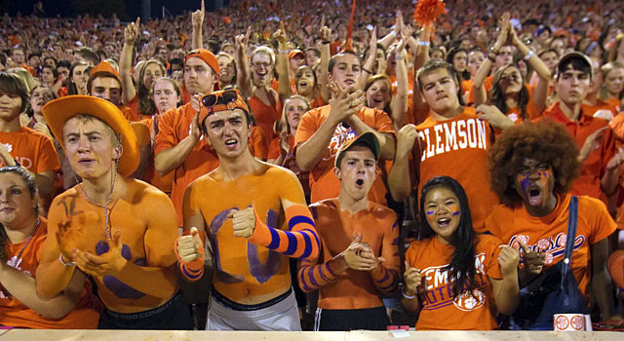
EVERY FAN BASE IS DIFFERENT
BUT THEY SHARE THE SAME ENTHUSIASM

Slide 6
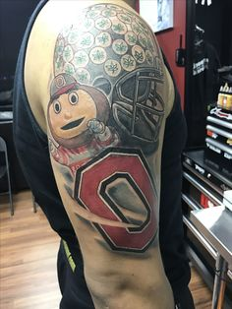
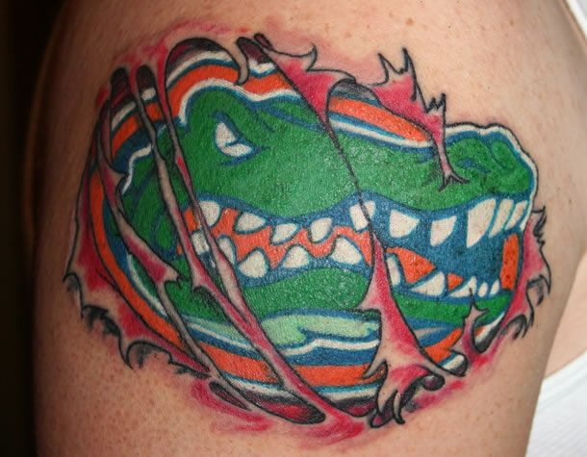
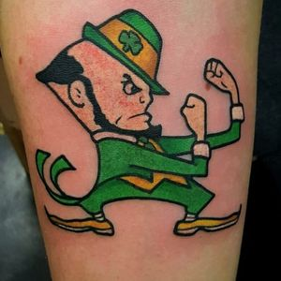
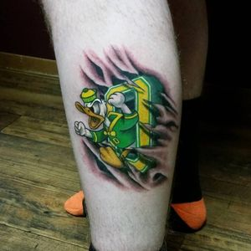
THE FAN(ATIC)
Few Industries have advocates tattoo logos on their bodies
They are emotionally invested
They hurt when they lose
They get frustrated and speak out
They want to be heard
You can help control those micro moments that impact their fan experience

Slide 7
ORACLE’S MISSION
Help sports teams see fan data in new ways, discover insights, and unlock endless possibilities in Fan Engagement.

Slide 8




































CURRENT CUSTOMERS

Slide 9

WHAT WE HEAR FROM SPORTS MARKETERS
Better connect with fans
Increase productivity at scale
Find new revenue sources beyond ticket sales
Win or Lose – Drive Engagement & Sell Tickets
Analyze and make decisions using data from multiple sources

Slide 10

ORACLE SPORTS MARKETING COMMUNITY
Eloqua for Sports Marketers User Group
Eloqua for Sports Marketers Slack Channel
Eloqua Sports Marketing LinkedIn Group
Partnership opportunities like customer events and User Groups

Slide 11
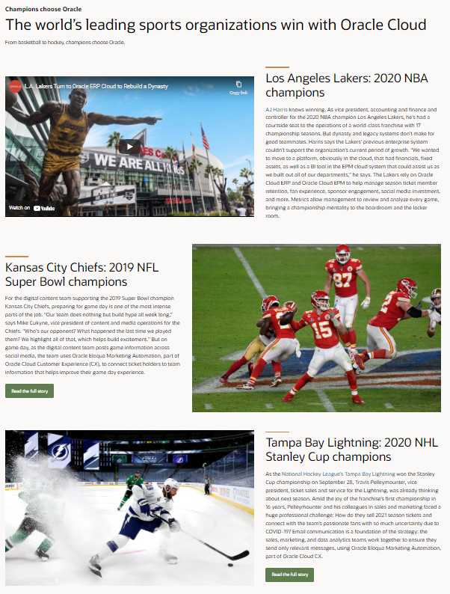
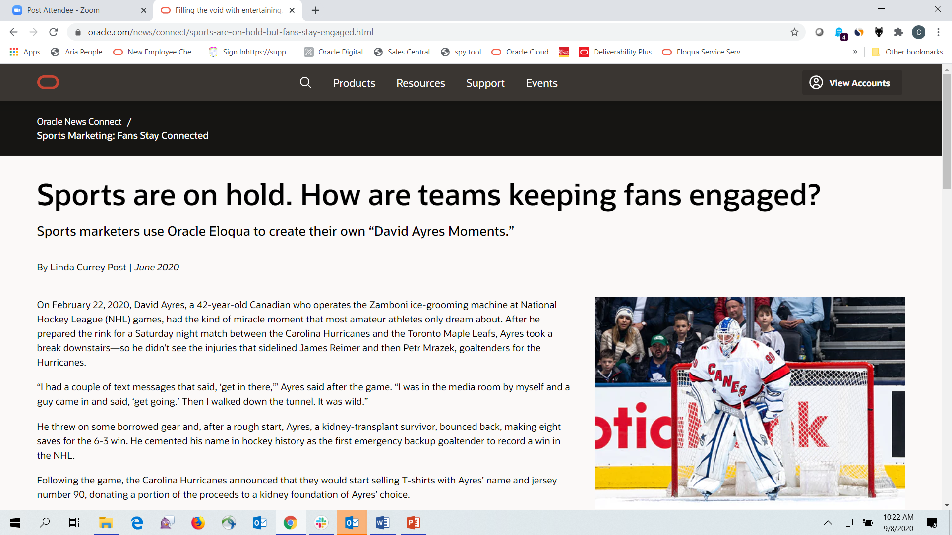
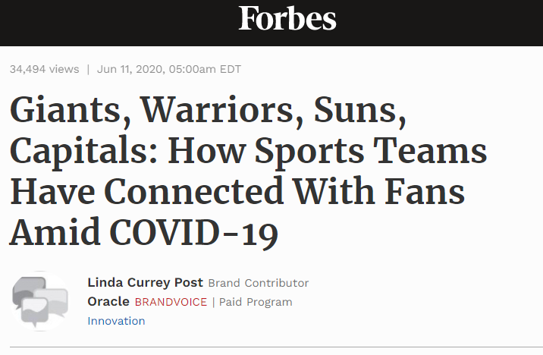
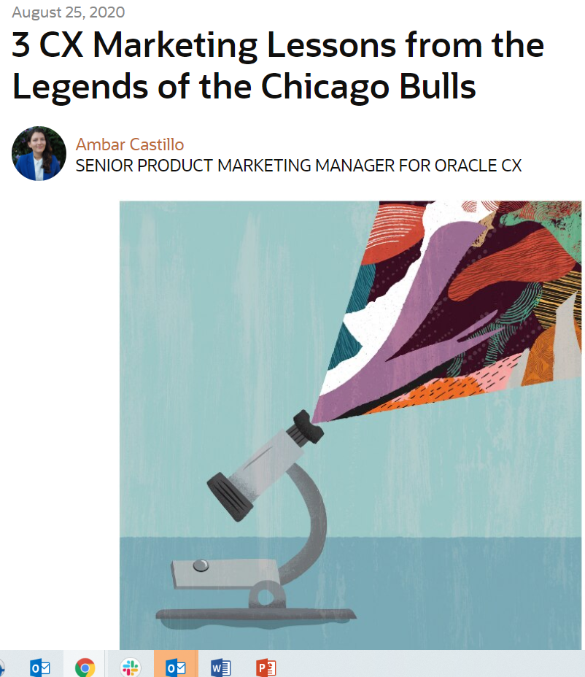
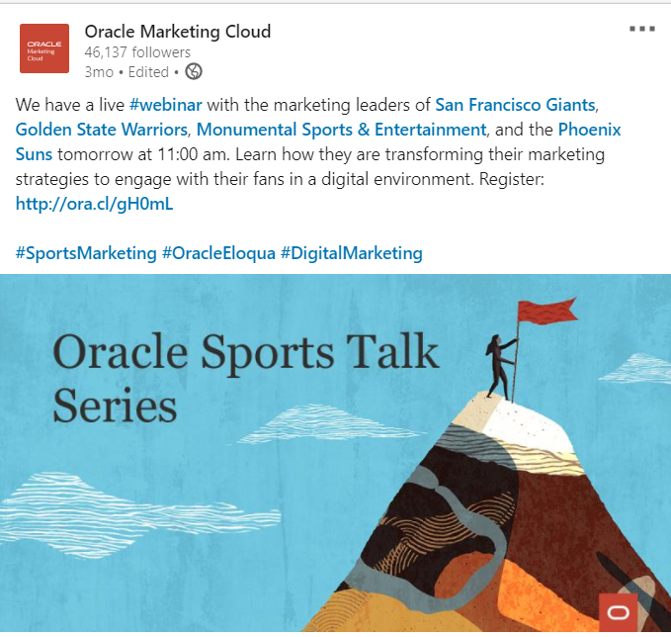
PROMOTING TEAMS

Slide 12



Slide 13
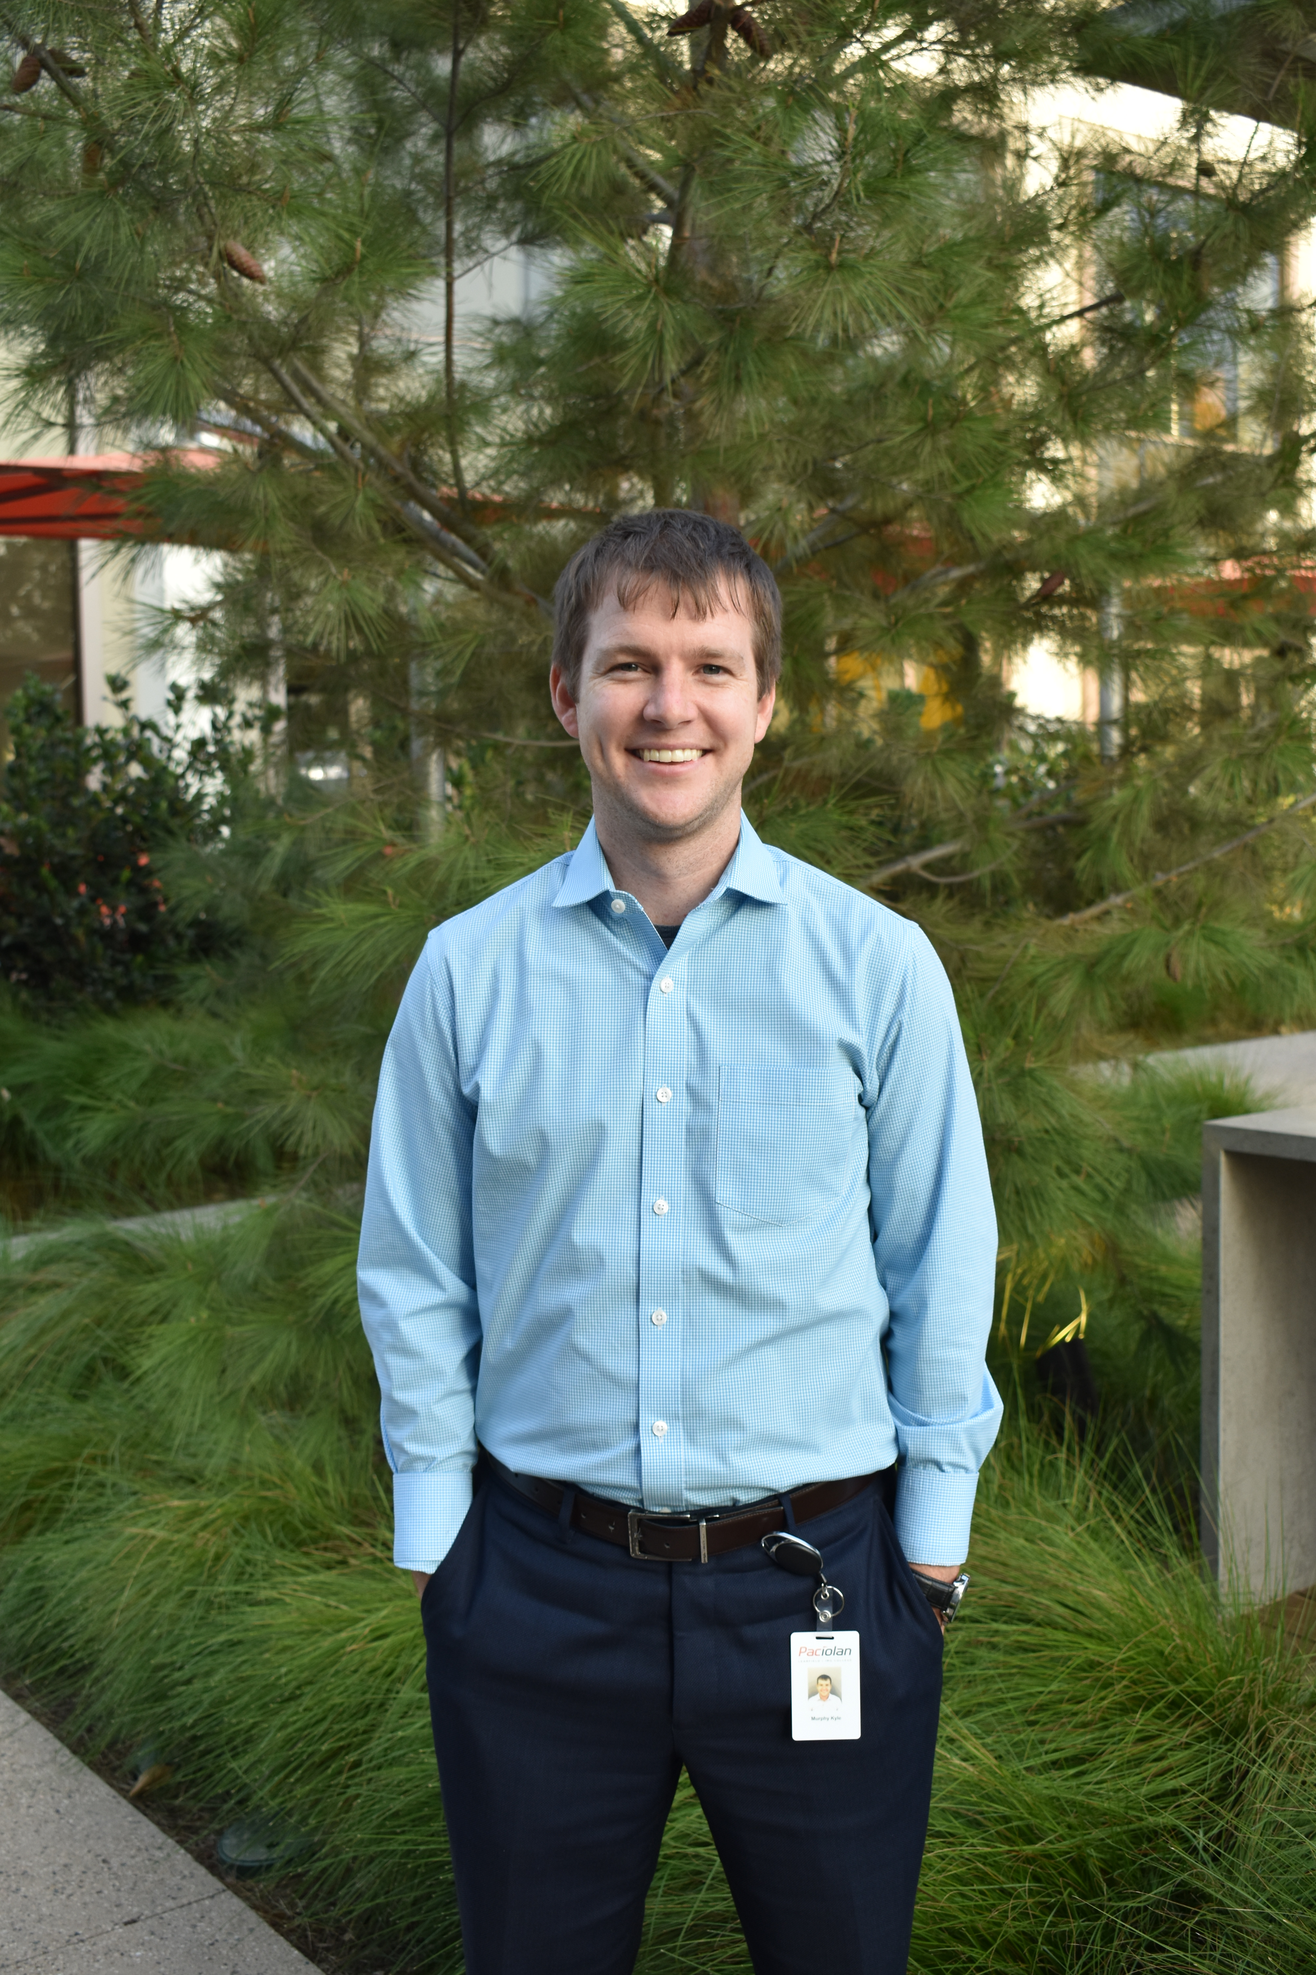
Kyle Murphy
Director, FanOne Marketing
Paciolan

Slide 14
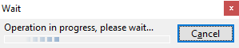

Slide 15
WHY ORACLE ELOQUA?
Advanced
Targeting and Lead
Management
Adaptive Campaign Management
Open Platform
Flexible Data Management
Sales & Marketing Alignment
Account Based
Marketing
Robust Reporting
& Analytics

Slide 16
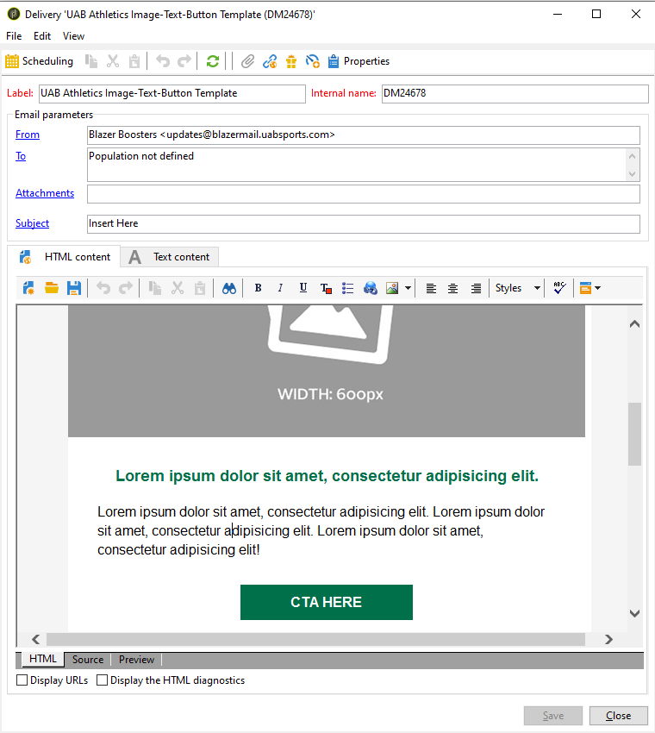
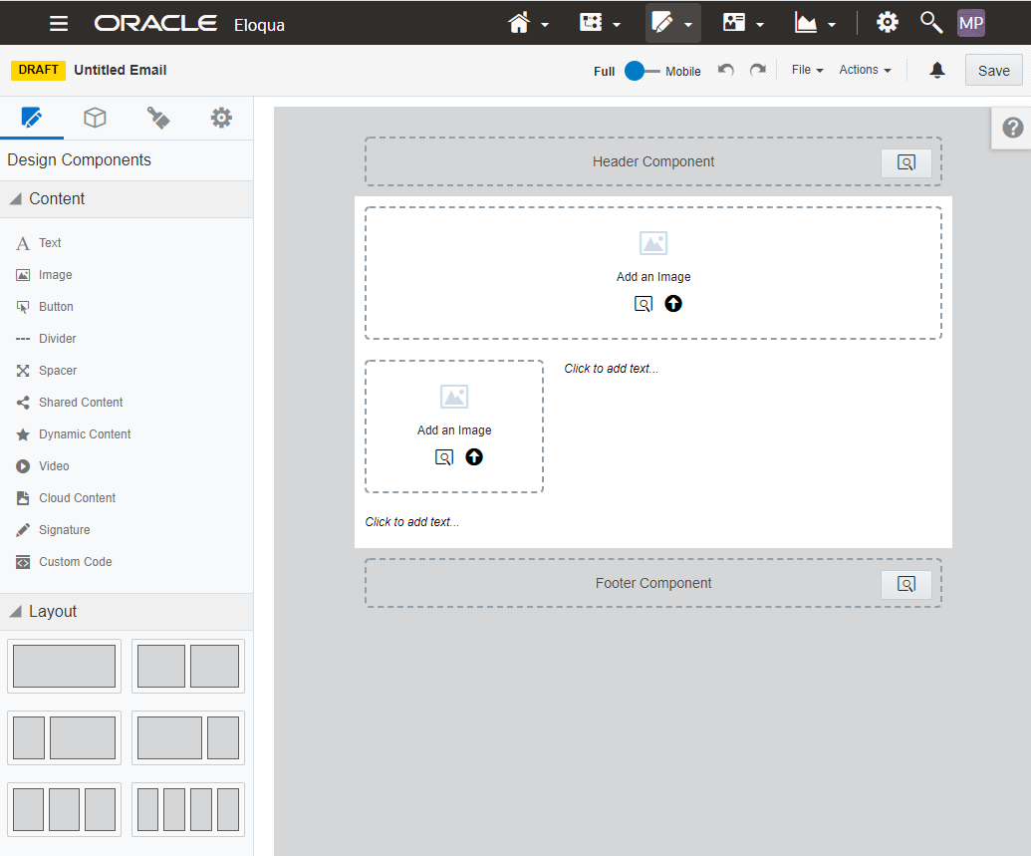
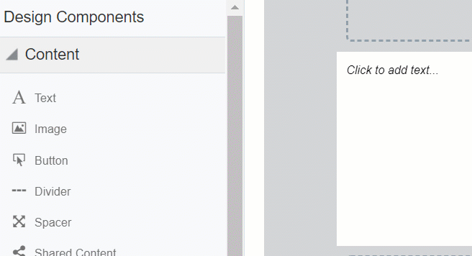
EFFICIENCY AT ITS BEST – EMAIL CREATION
Adobe Campaign
Oracle Eloqua
Notes:
We needed to find a platform that allowed for a more efficient email development process.

Slide 17
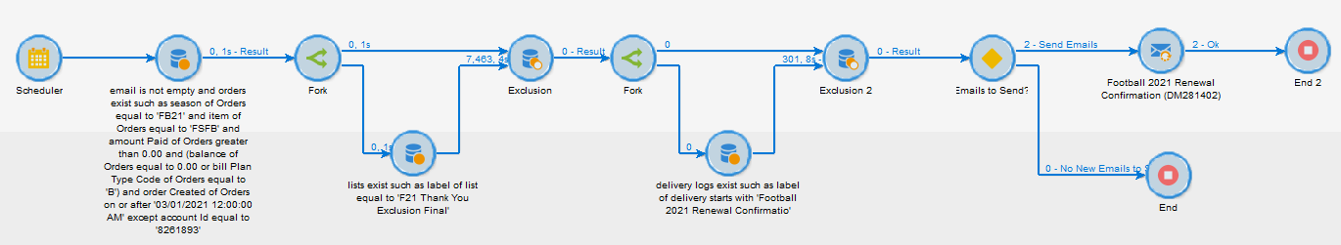
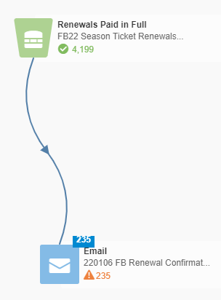
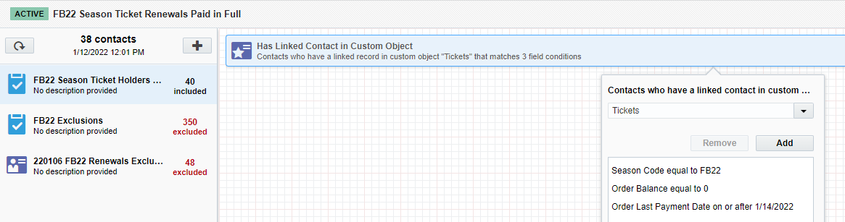
EFFICIENCY AT ITS BEST – AUTOMATED CAMPAIGNS
Adobe Campaign – 12 Steps
Oracle Eloqua – 2 Steps

Slide 18


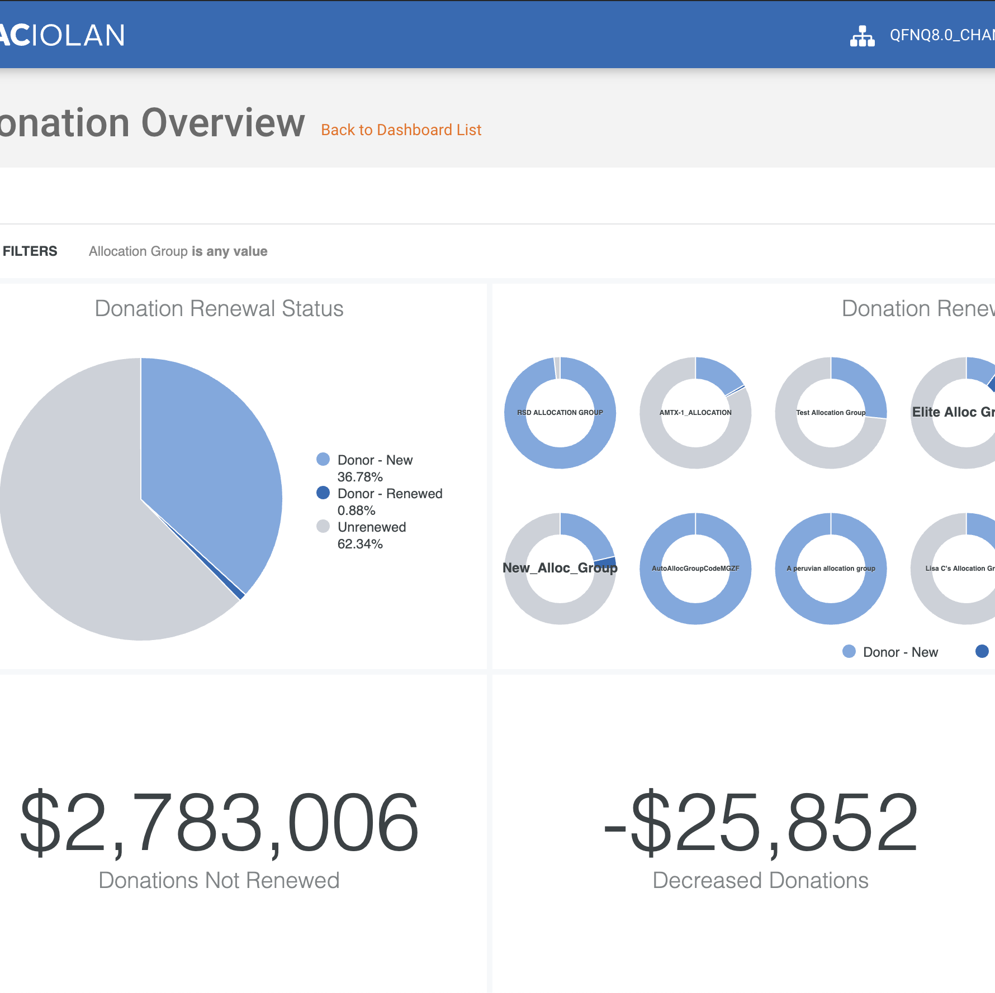







WHY ORACLE ELOQUA?
3rd Party Appends
DATA LAKE & WAREHOUSE
FULLY CLOUD-BASED
Notes:
We needed to find a tool that could easily integrate into our new data strategy and process.

Slide 19
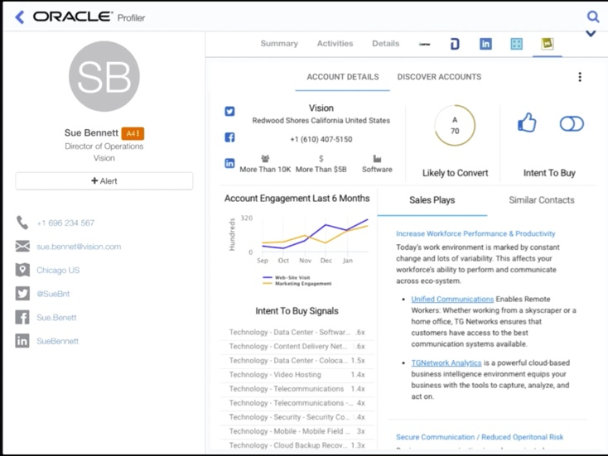
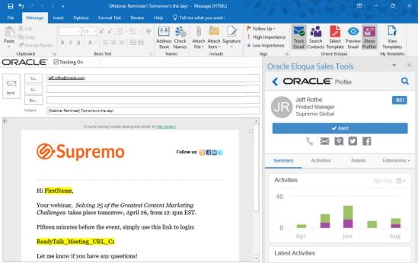

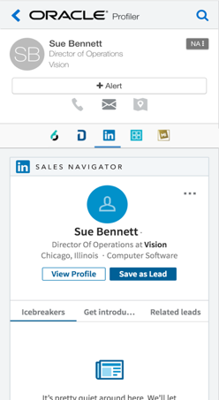
SALES & MARKETING ALIGNMENT
Eloqua Profiler
Eloqua Engage
Notes:
We needed to find a platform that allowed for a more efficient email development process.

Slide 20

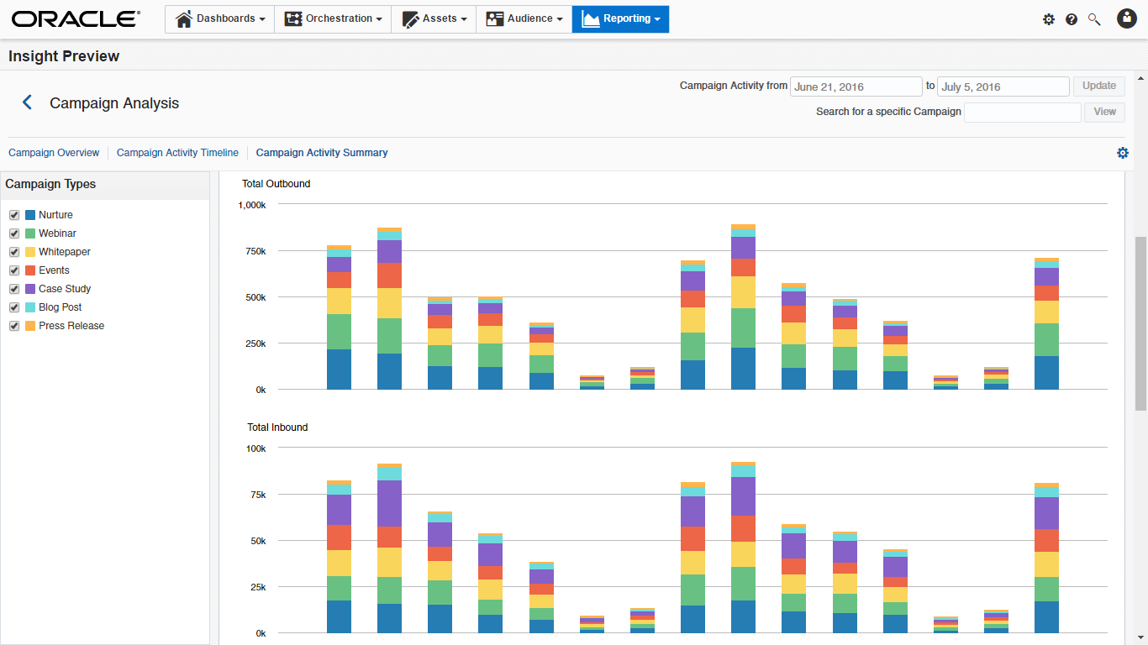
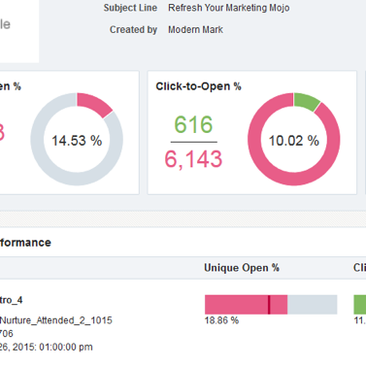
REPORTING & ANALYTICS
Dashboard with campaign analytics & reports
Reports showing real-time campaign generated revenue
Actionable data with details how each campaign is performing
Customizable dashboards and navigation
Notes:
We needed to find a platform that allowed for a more efficient email development process.

Slide 21



CLIENT TESTIMONIALS
“Our transition to Eloqua was seamless has been a complete game changer for our team. Because the platform is user-friendly and simple to use, it has made our marketing automation builds much more efficient and effective. Highly recommend making the switch!”
- Katie Larson, Kansas State Athletics
“The transition to Eloqua has allowed for greater flexibility in email creation while also saving time. The ability to use dynamic content allows us to easily deliver the right message to the right fan without building several different emails.”
- Haley Pfeil, Michigan Athletics
“Eloqua is a game changer for digital marketers everywhere; the ability to have templates that can change and be edited effortlessly allows marketers the flexibility to make changes on the fly. The forms and landing pages capabilities are just a few more additional benefits that go with this great platform, and we use them regularly to promote register to win and cyber club signups.”
- Rori Carlo, Xtream Arena &
GreenState Family Fieldhouse

Slide 22
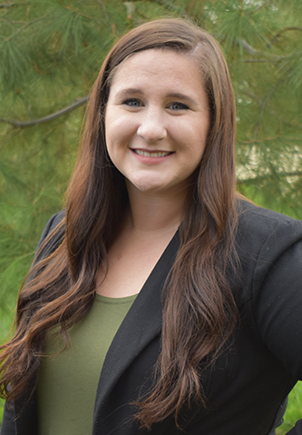
Michaela Patt
Marketing Automation Manager
Paciolan

Slide 23
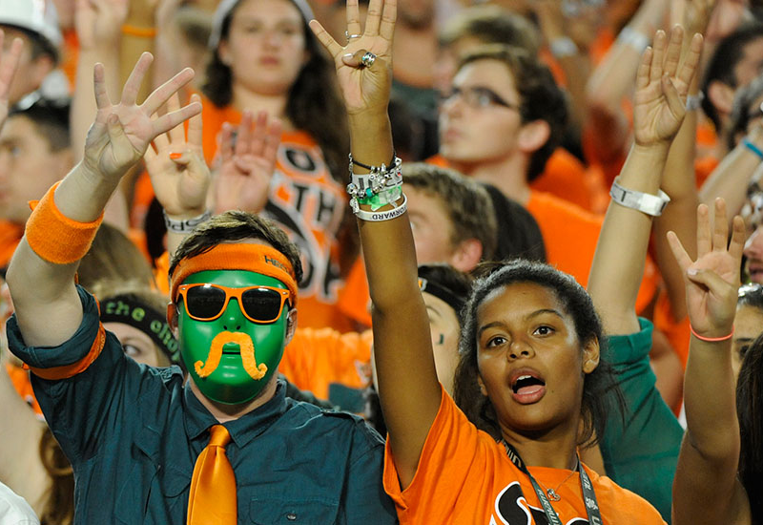
ELOQUA TRANSITION PROGRESS
46 Clients Live
  340 individuals trained
  on Eloqua
37 Clients Currently Transitioning
34 Clients Remaining
before July 1
We are headed into the 4th quarter!

Slide 24
ELOQUA USE CASE PROGRESS
Available
In progress
Not started
Implementation
Phase 1
Phase 2
(Summer ’21)
(Fall ‘21 – Summer ’22)
(Summer ’22 and beyond)
Email Templates
Subscription Management Form
Email Sign Up Form
Ticket Interest Form
New Purchaser Welcome Campaign
Reporting
Web Tracking
Cart Abandonment
Secondary Purchase/Donation Confirmation
Web Nurturing
Post Event Surveys
Native Lead Scoring
Personalized URLs
  Can utilize Adobe PURLs
  until July 1, 2022 and
  deliver through Eloqua
Invoices
  Can utilize Adobe invoices until July 1, 2022 and
  deliver through Eloqua
Custom Lead Scoring
Scan-In Campaigns
Behavior-Based Campaigns
Additional Opportunities
Notes:
Design may look different for PURLs/Invoices

Slide 25

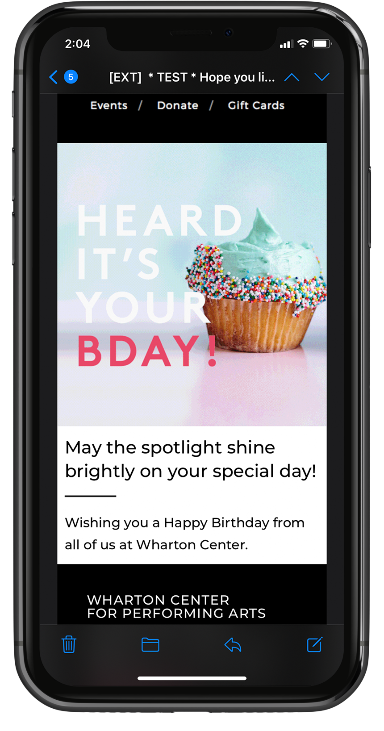
EXAMPLES OF LIVE CAMPAIGNS
Birthday Campaign

Slide 26
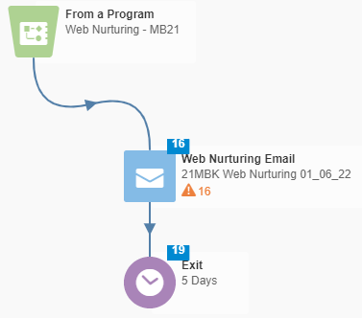
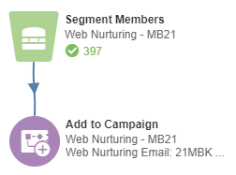

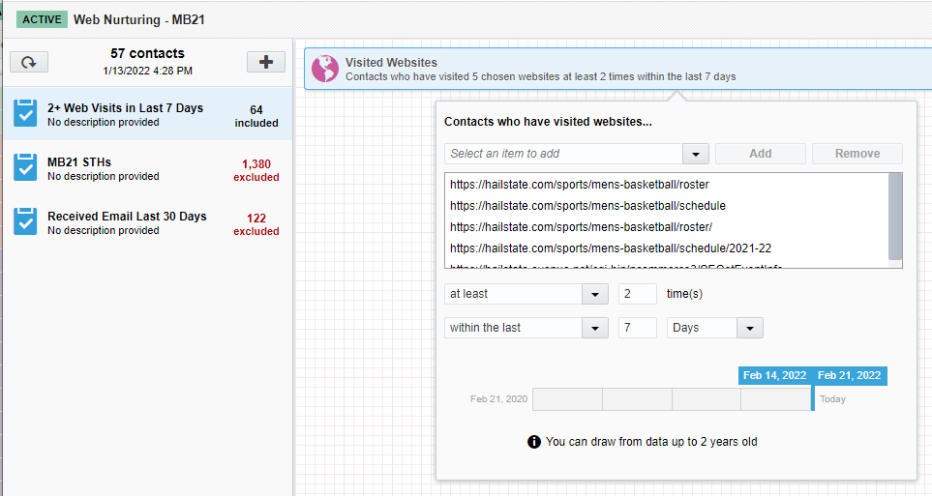
EXAMPLES OF LIVE CAMPAIGNS
Web Nurturing Campaign
This automation uses a program and a campaign to allow fans to receive the email multiple times

Slide 27
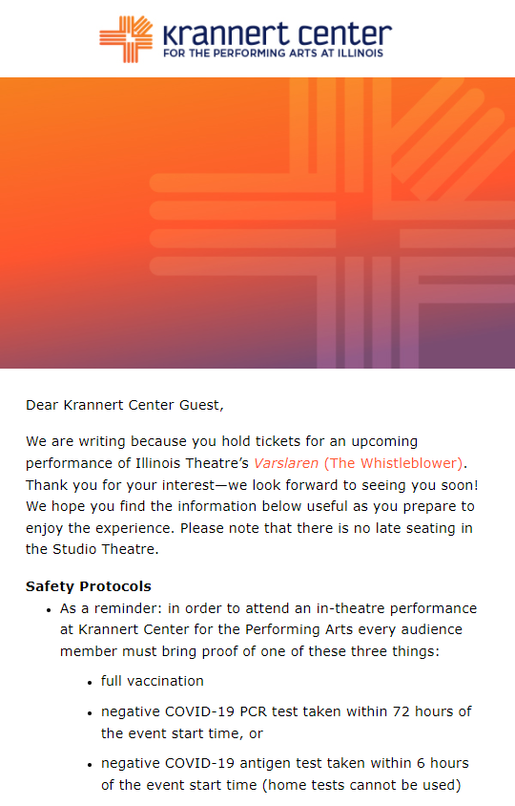
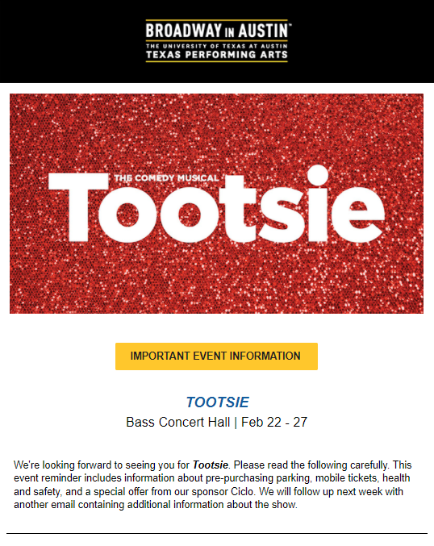
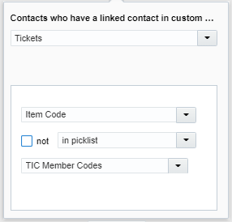
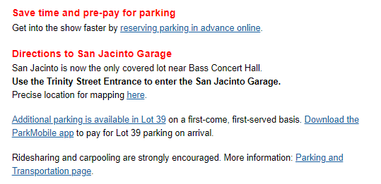
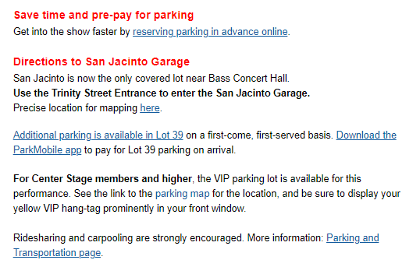
EXAMPLES OF LIVE CAMPAIGNS
Automated Event Reminders
Know Before You Go Emails with Dynamic Content
This email uses dynamic content to display the proper parking information for Texas Inner Circle members vs. the general public.

Slide 28
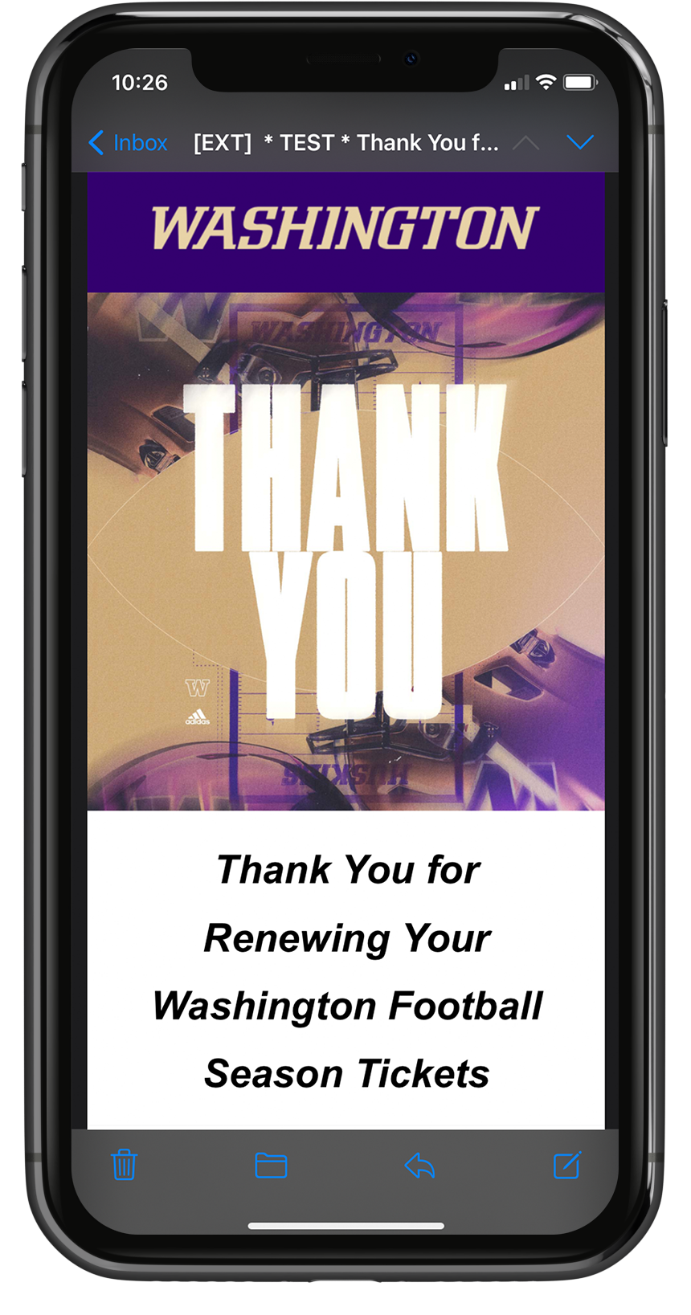
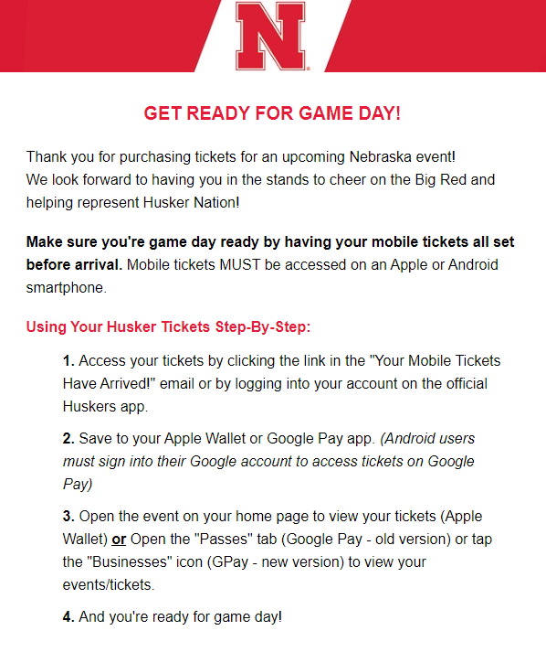
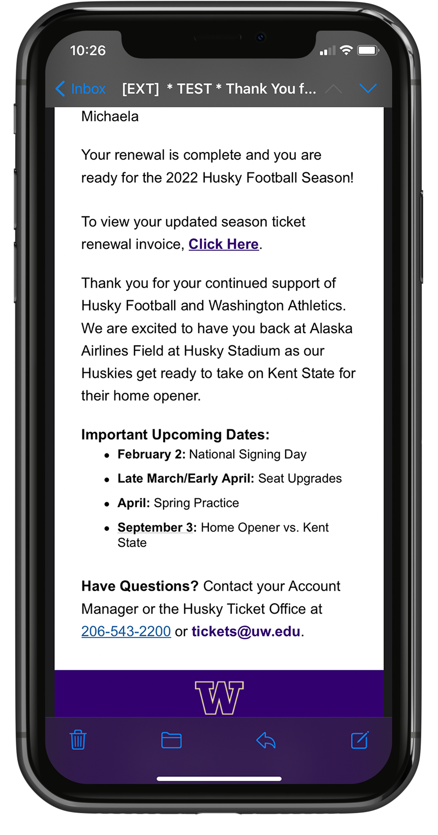
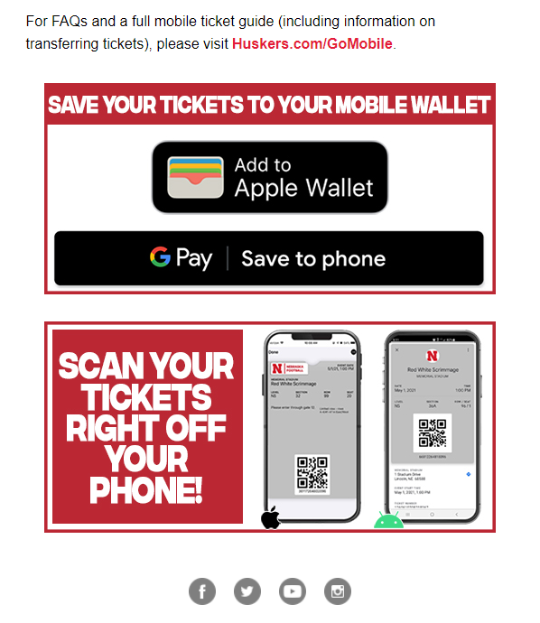
EXAMPLES OF LIVE CAMPAIGNS
Renewal Confirmation
Post-Purchase Mobile Ticket Reminders

Slide 29
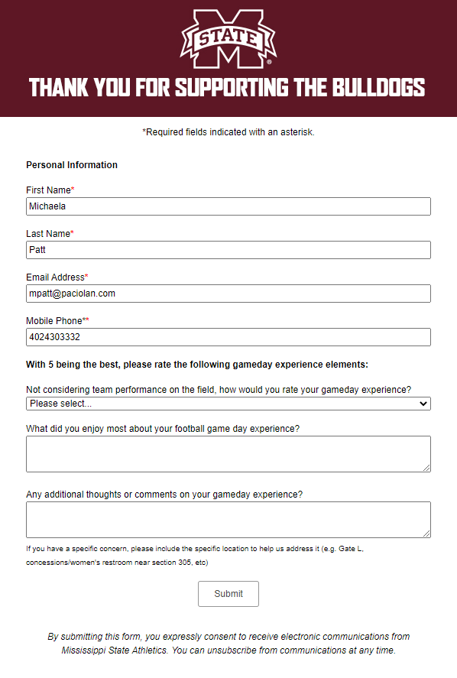
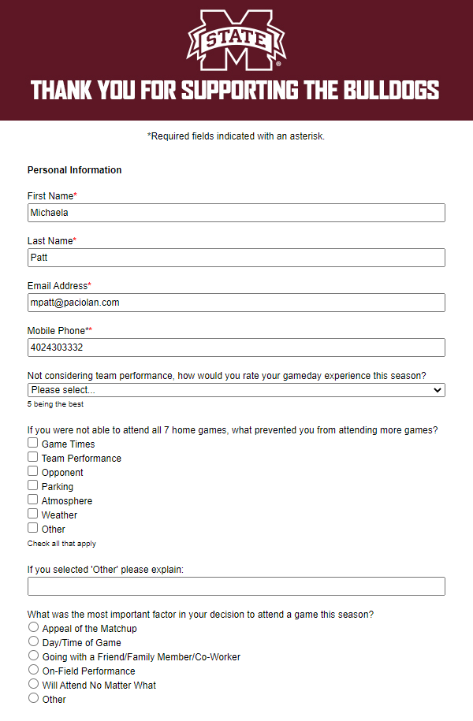
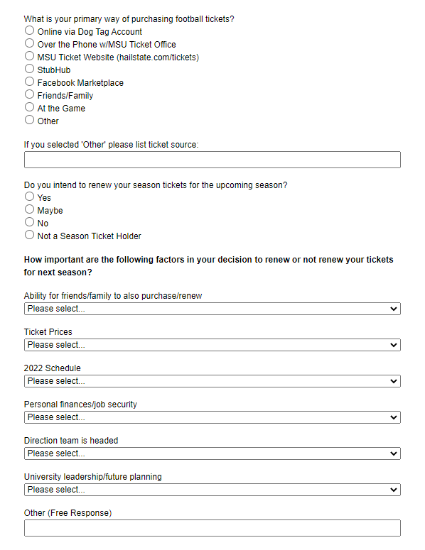
EXAMPLES OF LIVE CAMPAIGNS
Post Event Surveys
Post Season Survey

Slide 30
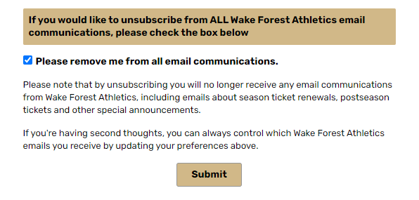
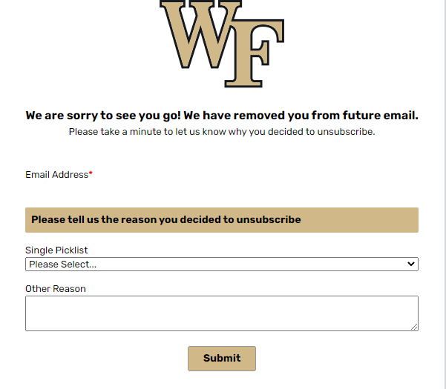
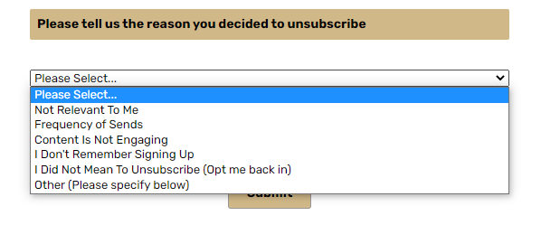
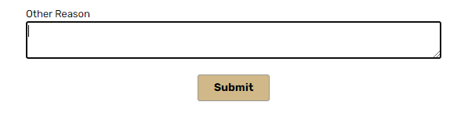
EXAMPLES OF LIVE CAMPAIGNS
Why Opt Out Form
If a fan opts outs using the subscription management form, they are redirected to a second form asking why the chose to opt out.
This will help gather more data on why fans are opting out and help shape strategy
in the future.

Slide 31


EXAMPLES OF LIVE CAMPAIGNS
PIN Request Form on eVenue
A fan can access the PIN request form from the Activate My Account page
on eVenue

Slide 32



EXAMPLES OF LIVE CAMPAIGNS
PIN Request Form on eVenue
Once the fan submits the form, a campaign is triggered that will email the fan with their unique information on how to log in to their account based on if they are linked, unlinked, or don’t have an eVenue account

Slide 33

EXAMPLES OF LIVE CAMPAIGNS
Donation Upgrade Form
This form combines field merges from the Membership Levels Custom Data Object and temporary values to populate personalized data and
solicit for a donation upgrade.

Slide 34
ELOQUA USE CASE PROGRESS
Available
In progress
Not started
Implementation
Phase 1
Phase 2
(Summer ’21)
(Fall ‘21 – Summer ’22)
(Summer ’22 and beyond)
Email Templates
Subscription Management Form
Email Sign Up Form
Ticket Interest Form
New Purchaser Welcome Campaign
Reporting
Web Tracking
Cart Abandonment
Secondary Purchase/Donation Confirmation
Web Nurturing
Post Event Surveys
Native Lead Scoring
Personalized URLs
  Can utilize Adobe PURLs
  until July 1, 2022 and
  deliver through Eloqua
Invoices
  Can utilize Adobe invoices until July 1, 2022 and
  deliver through Eloqua
Custom Lead Scoring
Scan-In Campaigns
Behavior-Based Campaigns
Additional Opportunities
Notes:
Design may look different for PURLs/Invoices

Slide 35


WHAT’S NEXT ON ELOQUA?
DATA CAPTURE FORMS / LANDING PAGES
User friendly data capture form building
Mobile responsive
Customizable processing steps
Form Spam Protection
UPCOMING LCS:
Eloqua Advanced Training – Forms
March 9th at 12pm PT (3pm ET)
5

Slide 36

WHAT’S NEXT ON ELOQUA?
MULTI-STEP EMAIL CAMPAIGNS
User friendly multi-step campaign builder
Nurture an interested prospect through the customer journey
Native drag/drop decision steps
Integrated reporting and insights
5

Slide 37




WHAT’S NEXT ON ELOQUA?
CART ABANDONMENT
Through a new web tracking tool called Infinity, we are now ready to start Cart Abandonment campaigns in Eloqua!
We can also trigger event/item view abandonment campaigns
The last viewed item and last item placed in cart is available will be available on the contact level
5

Slide 38
WHAT’S NEXT ON ELOQUA?
LEAD SCORING
Profile Fit
of Customer
A
1
Level of Interest
of Customer
Profile Score (A-D)
  How good of a fit are you?
  This can include demographic data, purchase history, donation history, etc.
Engagement Score (1-4)
  How interested are you?
  This can include email opens/clicks, web visits, form submits, etc.
Lead Scoring can inform revenue generating email campaigns, dynamic content, and can help provide the warmest leads to the sales team
Score | Description | Marketing Action
A4 | The right prospect but no interest. | Priority but may need specific “why now” messaging.
B1 | Good fit and very interested. | Send to sales queue for follow-up.
C1 | Not the ideal prospect but very interested. | Will they ever be a good fit? Continue to nurture.
D4 | Wrong Fit. No interest. | Fulfill request and segment out.
5

Slide 39

WHAT’S NEXT ON ELOQUA?
PERSONLIZED URLs
PURL templates have been transferred to Eloqua
We are now working on populating the necessary variable data to launch PURLs
5

Slide 40

WHAT’S NEXT ON ELOQUA?
PERSONLIZED URLs
With the drag and drop landing page builder, clients can eventually build their own PURLs with their own assets
The FanOne team would then take over to configure the variable data on the PURL
This will allow for more flexibility and shorter production timelines
5

Slide 41




WHAT’S NEXT ON ELOQUA?
ORACLE SPORTS COMMUNITY
5

Slide 42

THANK YOU!
QUESTIONS?
Please complete the online session evaluation.

