Slide 1
How To: Measure Marketing Success With Google Analytics

Slide 2
PRESENTER
Mark Baker, Paciolan
THANK YOU TO CONTRIBUTORS
Micayla Baker, Oklahoma City Civic Music Hall
Keith Bretzius, University of Michigan
Lance Dozier, Virginia Tech
Greg Driscoll, University of Virginia

Slide 3
Maintain focus on our goal: Measurement
We will not cover
Technical setup
Implementing Google Analytics
Cross-Domain Tracking
Words I will try not to say
Pixel
Cookie
If you need help in these areas
Reach out to your EOS to start
Checkout the blog posts on paciolan.com
Implementation
Cross-Domain Tracking

Slide 4
What will we cover?
Why you should use GA for marketing measurement
Common gaps preventing comprehensive measurement
How to prep for measurement in GA
Community examples
Thoughts on GA4

Slide 5
If you have questions along the way
Submit questions: bit.ly/pacnet22analytics
Q&A at the end

Slide 6
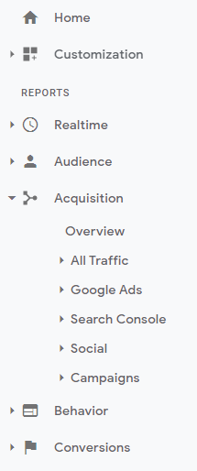
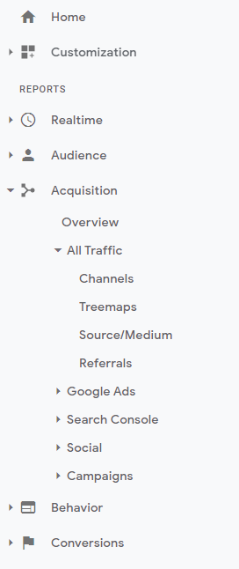
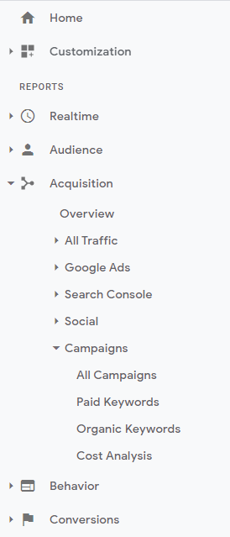
Clicks are all you need
Notes:
In this presentation, we are using Google Data Studio to present data
Nearly every evaluation can be done by clicking in the Google Analytics interface, mainly within Acquisition reports
No advance techniques are needed!

Slide 7
Why you should use Google Analytics
to measure marketing activity
Questions: bit.ly/pacnet22analytics
Notes:
Hypothetical comparison:
Guest services during your event watch attendees to see if they are happy.
They can read body language of attendees standing in lines to get in, see how people react to concessions, and more.
All of this shows how well your event is meeting the needs of the attendees
Google Analytics is much the same, but for your website. The visitors’ actions on the site will tell us if the site is meeting their needs.

Slide 8
Measure how visitors behave when you bring them to your site
Free, easily accessible, low barrier to entry
See how all efforts work toward achieving your goals
Use visitor behavior to inform digital efforts
Know if your efforts are generating any other outcomes
Notes:
Free, easily accessible, low barrier to entry
With a good tracking strategy, you can see all efforts working toward an overarching goal
Who is visiting?
Are visitors taking the desired action?
What efforts are working best?
Are there gaps preventing a complete picture?
Are there opportunities to improve or drive incremental results?
Know if your efforts are generating any other outcomes
Not a perfect solution for complete attribution
Defaults to last-click attribution, but you can compare models

Slide 9
What are common gaps
preventing complete measurement
Questions: bit.ly/pacnet22analytics

Slide 10
Links from emails, apps, and organic social posts must be tracked to see their impact
Email and App traffic will show as direct traffic
Measuring traffic from apps can help show value
Discover how your organic social posts contribute to goals
Notes:
Email and App traffic will show as direct traffic
Give credit where it is due
Need to see how these efforts impact your goals
Find opportunities to improve or generate incremental results
Measuring traffic from apps can help show value
Shift to digital tickets help drive downloads of apps, but they can be used for more than managing tickets
Discover how your organic social posts contribute to goals
Learn what content on organic channels drives results
Explore other social opportunities
Strategize organic posts to support sales efforts
How much impact could not tracking your emails have?

Slide 11
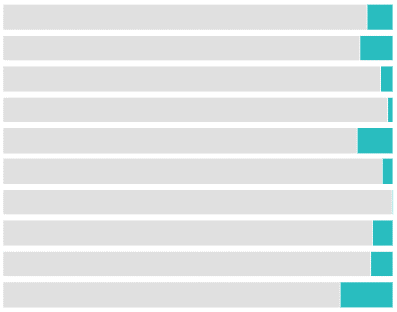
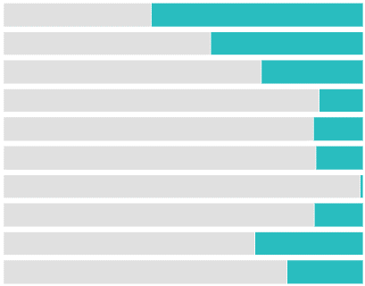
On average, email makes up 5% of traffic, but generates 30% of revenue
Email Sessions by Site
Email Revenue by Site
Sample of 10 Paciolan clients across genres, July 1, 2021 – January 31, 2022
Notes:
Each bar represents a site with the email channel highlighted in teal, each section represents other channels like organic search, display, social, etc.

Slide 12
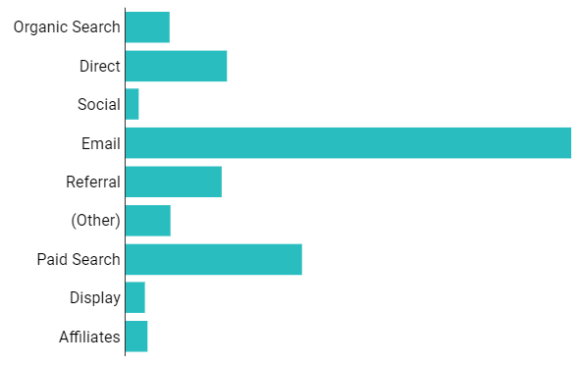
Email is the most efficient marketing channel
Aggregate Channel Conversion Rate
Sample of 10 Paciolan clients across genres, July 1, 2021 – January 31, 2022
Notes:
All of this leads to the conclusion email is often the most efficient and effective marketing channel, supported by overall conversion rates across those 10 sites

Slide 13
How to prepare for measurement
Questions: bit.ly/pacnet22analytics

Slide 14
Add tracking tags to all links distributed as part of your campaign
Campaigns represent a product, idea, or goal
Mediums are how the visitor came to you
Sources are where the visitor came from
Content can be used to further define the source
Notes:
Campaigns should represent a product, idea, or goal
May include multiple “campaigns” from different platforms
Football Season Ticket search campaign and Football Season Ticket social campaign would both be tracked in the “fbseason” campaign
Mediums should be how the visitor came to you
email, paidsearch, paidsocial, display, social, app, etc.
Sources should be where the visitor came from
Google, facebook, Instagram, twitter, notification, etc.
Email sources are best defined by what the email was
Announcement, presale, onsale, TWI…, reminder1, finalReminder, etc…
Content can be used to further define the source
Very helpful for social to describe what was in the post

Slide 15
Add tracking tags to the end of all urls
Your-evenue-site.net
&utm_source=whereTheVisitorCameFrom
&utm_medium=howTheVisitorCameToYou
&utm_campaign=productOrGoal
&utm_content=whatWasInTheAd
Your-evenue-site.net &utm_source=where&utm_medium=how&utm_campaign=product&utm_content=content
*Note*
Add RSRC / RDAT values on eVenue destinations before GA tags
When not directing visitors to eVenue, the first & should be a ?
Google Campaign URL Builder
https://ga-dev-tools.web.app/campaign-url-builder/
Notes:
Campaign tracking tags, often called “utm codes” are added to the end of your destination URL
They can go in any order, but most often as source, medium, campaign, then content

Slide 16
Map out your plan and be prepared to adjust
fbseason
email
paidsearch
social
app
presale
google
facebook
onsale
onsale
instagram
reminder
final
Reminder
twitter
deadline
automation
tiktok
extended
Notes:
Theoretical campaign:
Campaign in purple: fbseason
Mediums in teal (not all are represented)
Sources within each medium are in grey
With a consistent structure used across all efforts, you’ll be able to get a good view of what is contributing to specific campaigns, as well as how each medium or source contributes to your site overall.

Slide 17
There is no one correct way to track campaigns
The only wrong way, is not tracking at all

Slide 18
Examples from the Community
Questions: bit.ly/pacnet22analytics

Slide 19
OKC Civic Center Music Hall has a simple and effective email tracking strategy
All links in emails use one of the following sources
presale
onsale
promo
monthly
nudge1
nudge2
kbyg
okcciviccenter.com Google Analytics, July 1, 2021 – January 31, 2022
Notes:
Simple, effective email tracking structure allows for easy, comprehensive measurement of all efforts.
Easily see how each of these types of emails contributes to on site behavior and performance
Presale – Promoter requested, paid engagement between OKC and the promoter
Onsale – Sent to patrons who requested to receive an email when a specific event goes on sale through special forms built with our FanOne team
Could also be sent to a larger segment if requested by the promotor for a fee
Promo – special offer or discount on a ticket
Nudges – General sales email dedicated to a specific show, not including any special promotions. Again, requested by the promoter for a fee
Kbyg – know before you go

Slide 20
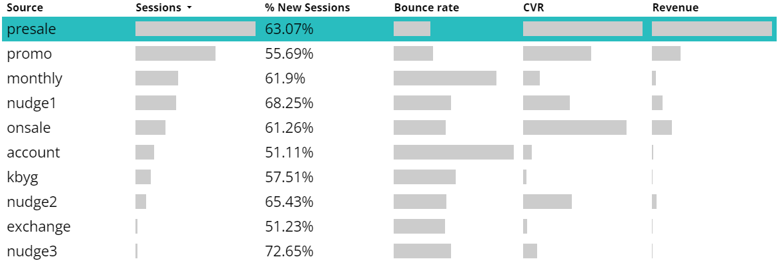
OKC’s presale emails are most important, but can we improve monthly emails’ performance?
okcciviccenter.com Google Analytics, July 1, 2021 – January 31, 2022
Notes:
When viewing the email acquisition channel, we can clearly see performance for all types of emails
Presales are most valuable, and this performance can be used to sell the engagement with promoters. It’s easy to sell someone on an average CVR close to 12%
The onsale email targeting explains the relatively low session count and extremely high conversion rate, over 10%
Nudges could also be an easy sell to promoters, but there’s clearly a diminishing return as more are sent.
Monthly emails stand out here, requiring further evaluation. This is a regular engagement piece with patrons, and the number of sessions are out of proportion to behavioral metrices like bounce rate, CVR, and Revenue

Slide 21
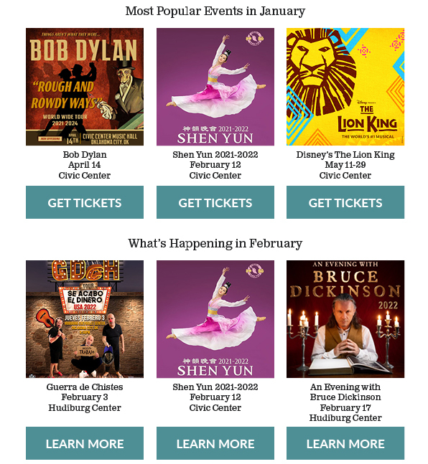
Each link has a campaign associated with the show
All links use
  “monthly” as the source
  “email” as the medium
  The month the email was sent as content
&utm_source=monthly&utm_medium=email&utm_campaign=bobdylan&utm_content=january
&utm_source=monthly&utm_medium=email&utm_campaign=shenyun22&utm_content=january
&utm_source=monthly&utm_medium=email&utm_campaign=brucedickinson&utm_content=january
okcciviccenter.com Google Analytics, July 1, 2021 – January 31, 2022
Notes:
Before diving deeper, we need to know how each link in the monthly email is coded
All links have the same source, medium, and content. The only thing that changes is the campaign, which represents each show.

Slide 22
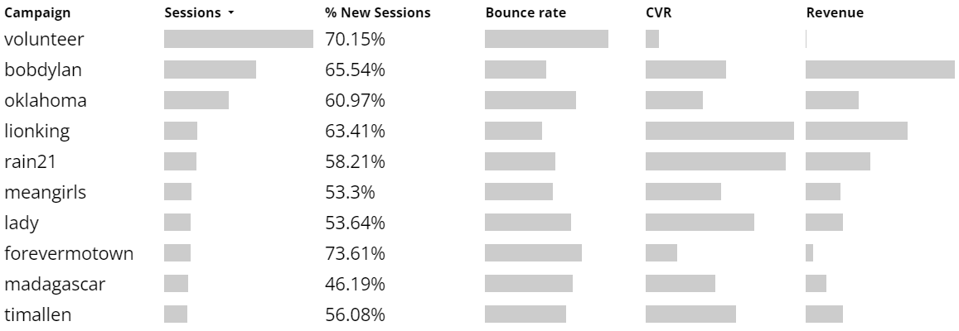
Generating more sessions from Broadway events could generate incremental results
okcciviccenter.com Google Analytics, July 1, 2021 – January 31, 2022
Notes:
As we evaluate monthly emails
The first thing that stands out is the volunteer campaign, which is generating most of the sessions, but the intent behind that click is extremely unlikely to buy a ticket
Volunteer base after covid not yet comfortable coming back, link goes to okcciviccenter volunteer page, trying to more volunteers – goes to a third party system, no data
If the volunteer campaign is generating most of the sessions, then the question becomes how can we get more clicks to the items that will drive results.
Broadway events have very good CVR and strong revenue, but relatively low sessions – can anything be done to entice patrons to click these events?

Slide 23
Are viewers being confused by messaging?
okcciviccenter.com Google Analytics, July 1, 2021 – January 31, 2022
Notes:
All events listed under “popular events in January” do not happen in January
How would that be different than “what’s happening in February?”

Slide 24
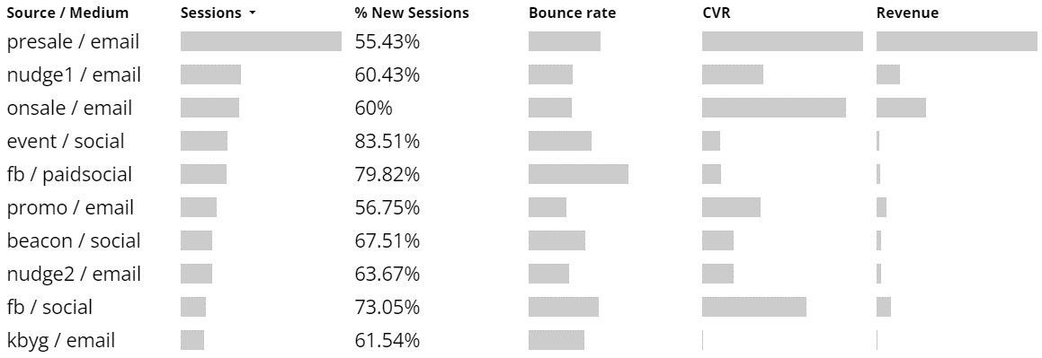
Not all channels drive direct sales, that’s okay
okcciviccenter.com Google Analytics, July 1, 2021 – January 31, 2022
Notes:
Looking at how everything comes together under a campaign, email is clearly driving the most value
But the other channels that may not appear as performant can be contributing in other ways
Event/sales driven social posts may not be directly driving revenue, but they are helping with awareness and consideration as good contributors to session volume
More organic social approaches had higher conversion rates, but not as much volume. This could be an opportunity to post more often about upcoming events to help support the overall campaign.

Slide 25
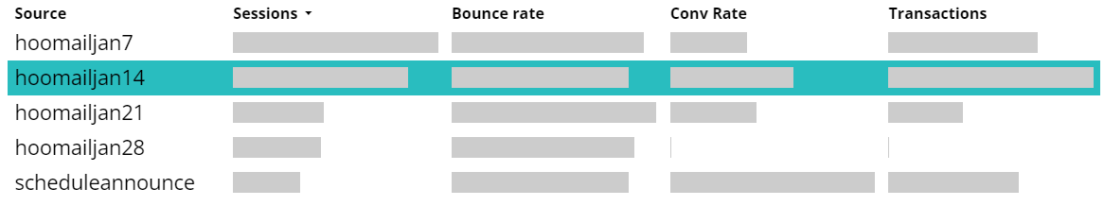
Why did Virginia’s HooMail on Jan 14 generate more football deposits than other emails?
virginiasports.com Google Analytics, Jan 1, 2022 – February 2, 2022
Notes:
Football deposits advertised via a banner in all HooMails, UVA’s regular athletics update email
Why could the January 14 email have had such a better CVR than the other HooMails in January?

Slide 26
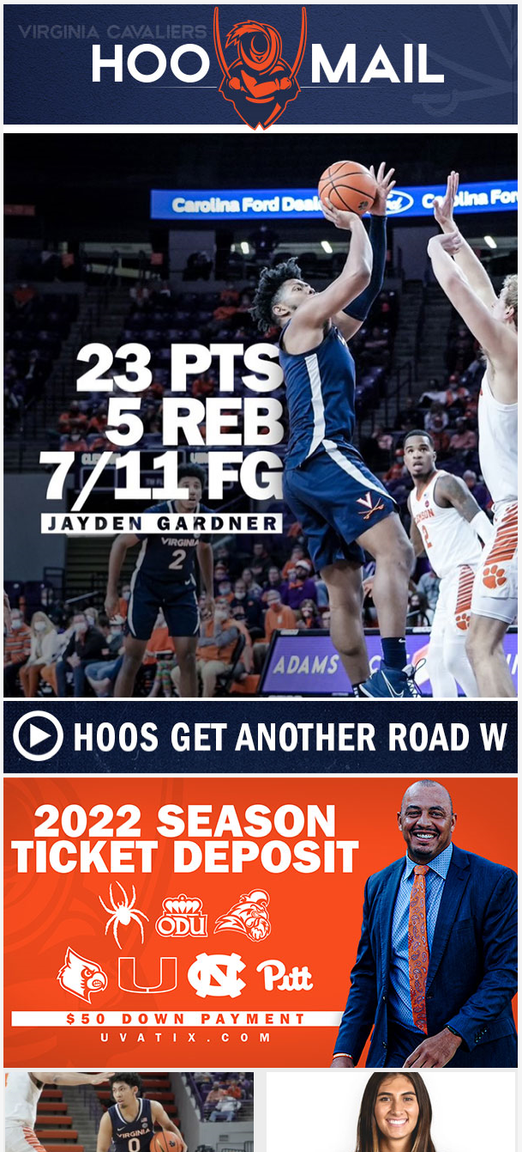
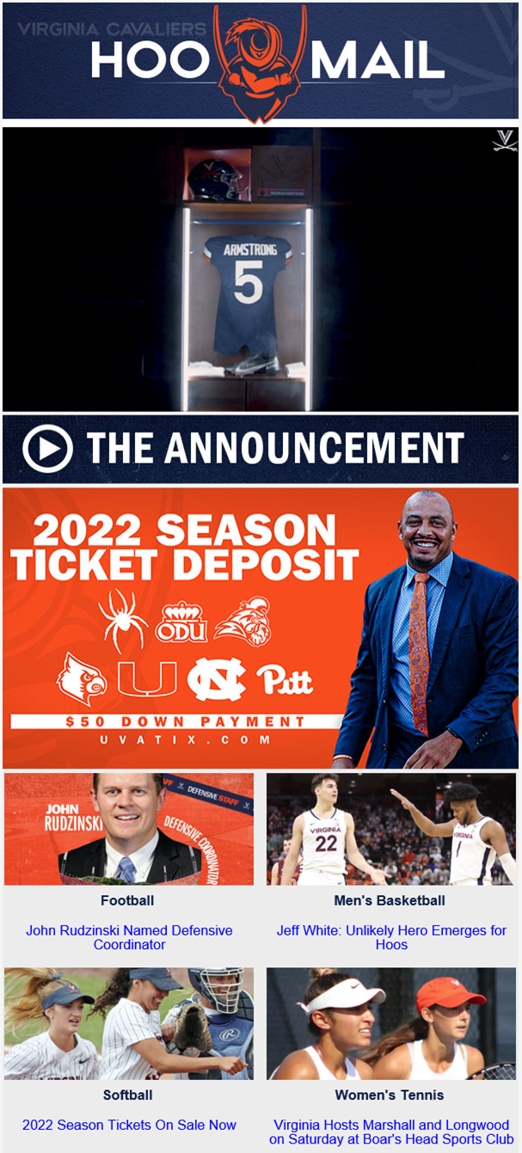
Small changes can generate incremental results
Jan 7
Jan 14
Notes:
The content above the banner in the Jan 7 email was not Football related. On top of that, the image was longer, require a longer scroll to get to the deposit banner.
The Jan 14 email included a link to a video about the Hoos QB returning immediately above the banner for football deposits. The positive nature of the content and the mere fact it was directly related to the content a fan just scrolled past, may have contributed to the relative success.
Small changes to content in emails could generate incremental results.

Slide 27
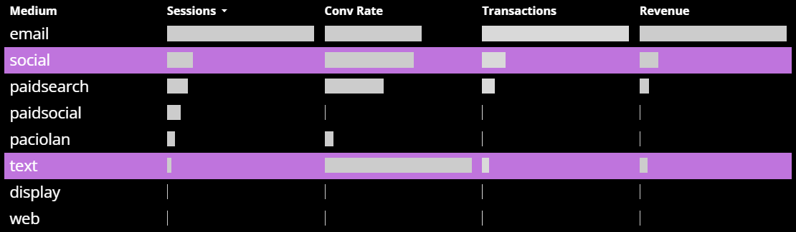
Michigan’s Football Single Tickets campaign uncovered new opportunities for growth
mgoblue.com Google Analytics, July 1, 2021 – November 27, 2022
Notes:
Once again, we can see email as the top contributor to a campaign
Paid search is also very efficient and could potentially use more investment
But there are other opportunities that jump out in organic social and text messages, both of which had massive CVRs and generated an unexpected amount of revenue

Slide 28
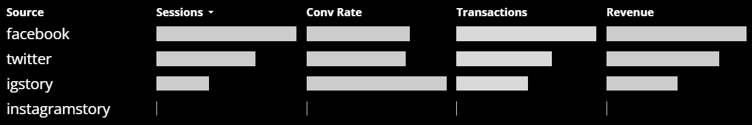
Organic social can drive action and revenue
mgoblue.com Google Analytics, July 1, 2021 – November 27, 2022
Notes:
Over 11K sessions
Aggregate CVR over 3% - Typically, organic social is well under ½ a percent
Over $80K revenue generated
All sessions and revenue occurred in the first three weeks of July
IG Stories is particularly interesting – with such a high CVR, how can we generate more sessions from this source for sales efforts? Can this work for other sports?
Yes – over $7K sold attributed to sessions originating from organic IG Stories

Slide 29
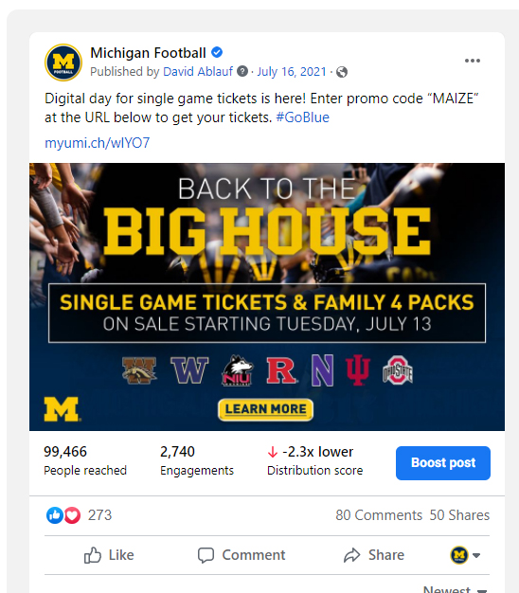
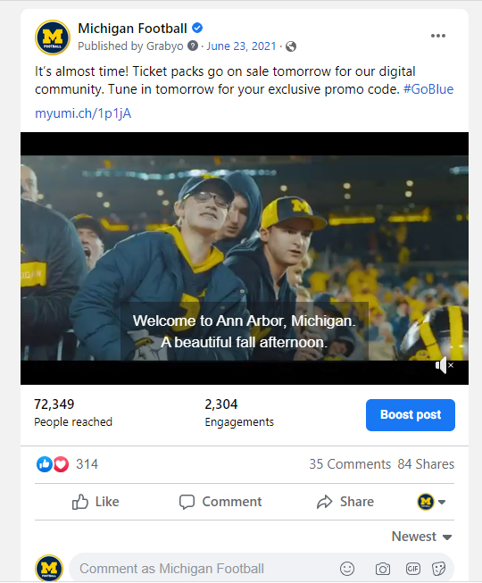
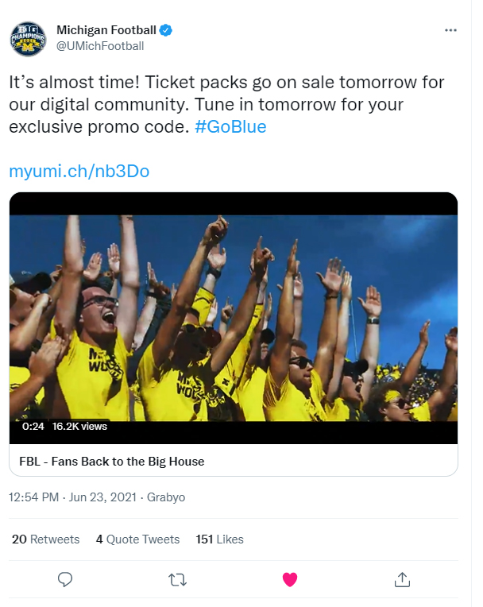
Organic social examples
mgoblue.com Google Analytics, July 1, 2021 – November 27, 2022
Notes:
Each post builds anticipation, shows the experience, and contains a tracked link back to mgoblue.com or evenue.

Slide 30
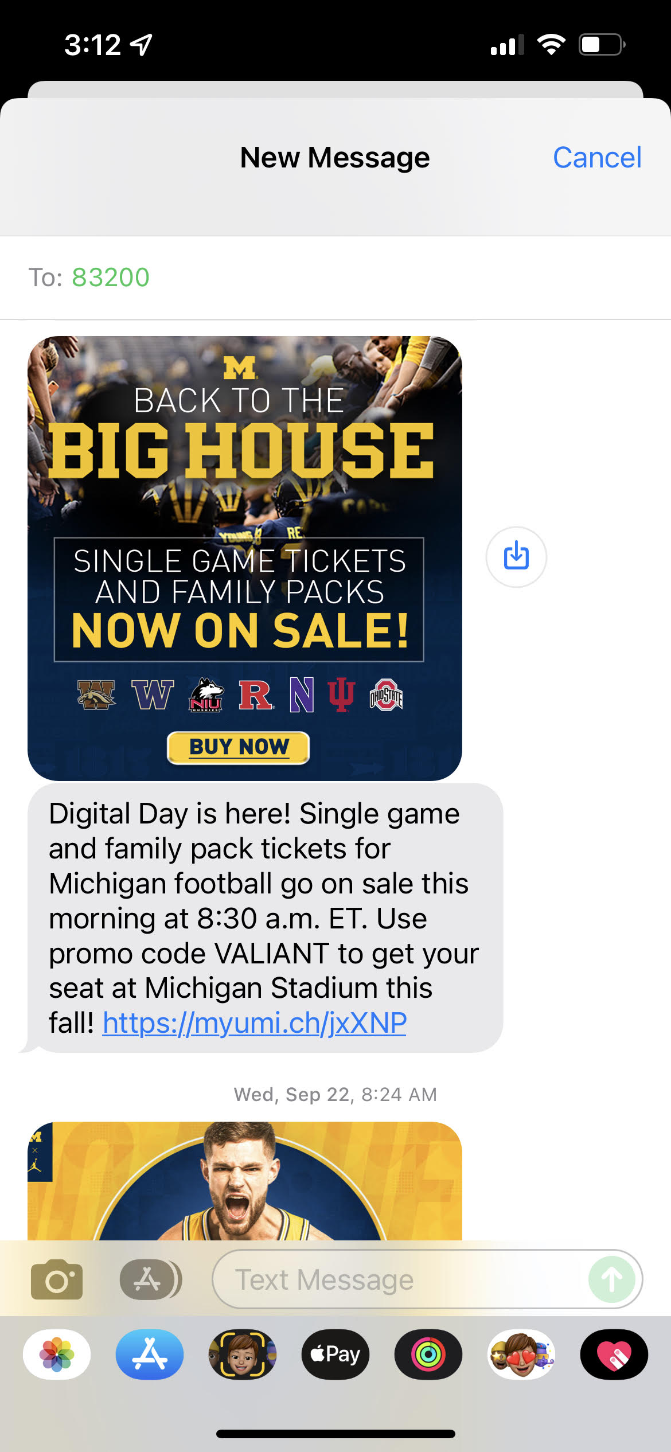
Timely text efforts can be valuable
One text sent on Michigan’s “Digital Day” for Football Singles
Over 2,000 sessions
Conversion rate over 5%
More than $37K attributed revenue
mgoblue.com Google Analytics, July 1, 2021 – November 27, 2022
Notes:
Text sent through mozeo.com – partners with Sidearm
Will this continue to be successful as we transition to push notifications? How much overlap? Is it a different audience? Can this work for renewals?

Slide 31
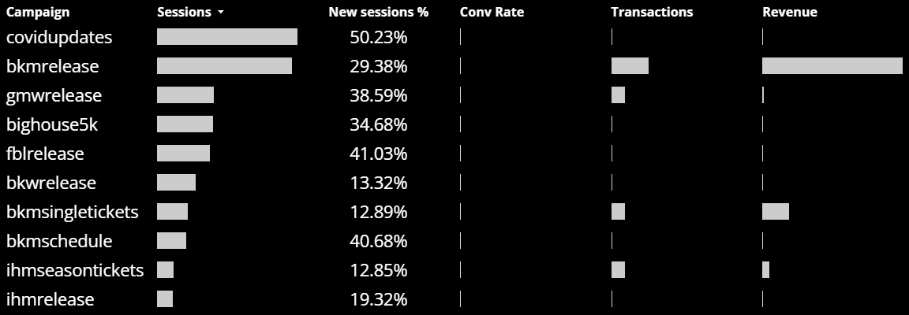
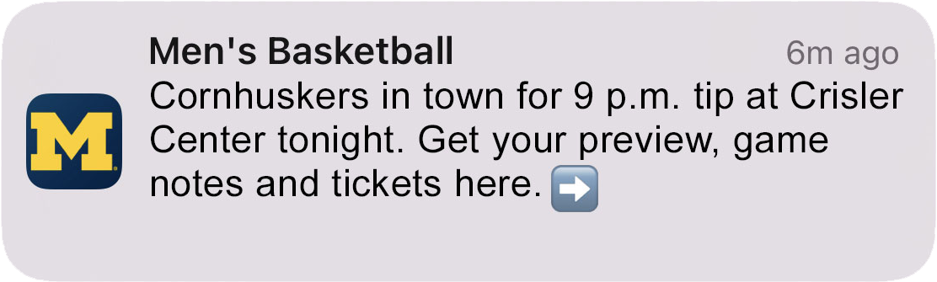
Find how best to leverage your app notifications
mgoblue.com Google Analytics, January 1, 2022 – February 14, 2022
Notes:
Over 127K sessions from push notifications this year alone
Typical new session % for most sites is around 75%, the lower % of new sessions from app notifications shows we are keeping fans engaged with the brand. The exceptionally low percentage of new users for the ticketing-focused campaigns is a small success – they are reaching the right fans who are actively engaged and more likely to purchase
BKMRELEASE only includes game previews/game notes/game promotions for push notifications, which include a passive CTA for tickets
There is value beyond driving direct revenue.
In this case, we are reaching existing fans with necessary info in the covid updates, relevant content to consume with release notifications, and we can make sure to build audiences for remarketing from either these sources or the landing pages used in the notification.

Slide 32
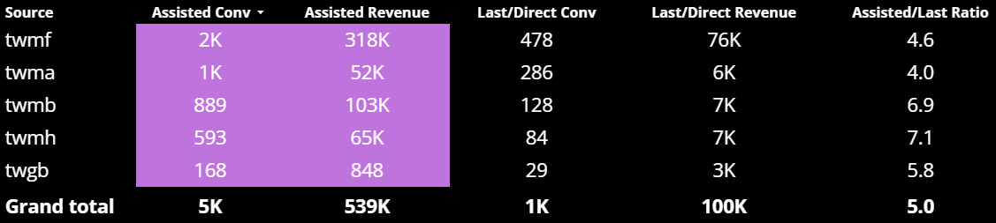
Content-focused emails help sell tickets later
Assisted Conversions:
Conversions occurring with the source on the sales path, but when it is not the final interaction
mgoblue.com Google Analytics, January 1, 2022 – February 14, 2022
Notes:
Trying to get more content marketing analysis and showing value down the line
Twmb, twmh, and twgb are relatively new – basketball started two-three years ago, hockey 1-2 years ago, and twgb started during the pandemic – never intended to sell tickets, but it has shown revenue potential now
Builds the connection with the fan to help them make the purchase later
A lot of effort put on these emails to balance the communications goals and marketing goals to sell tickets

Slide 33
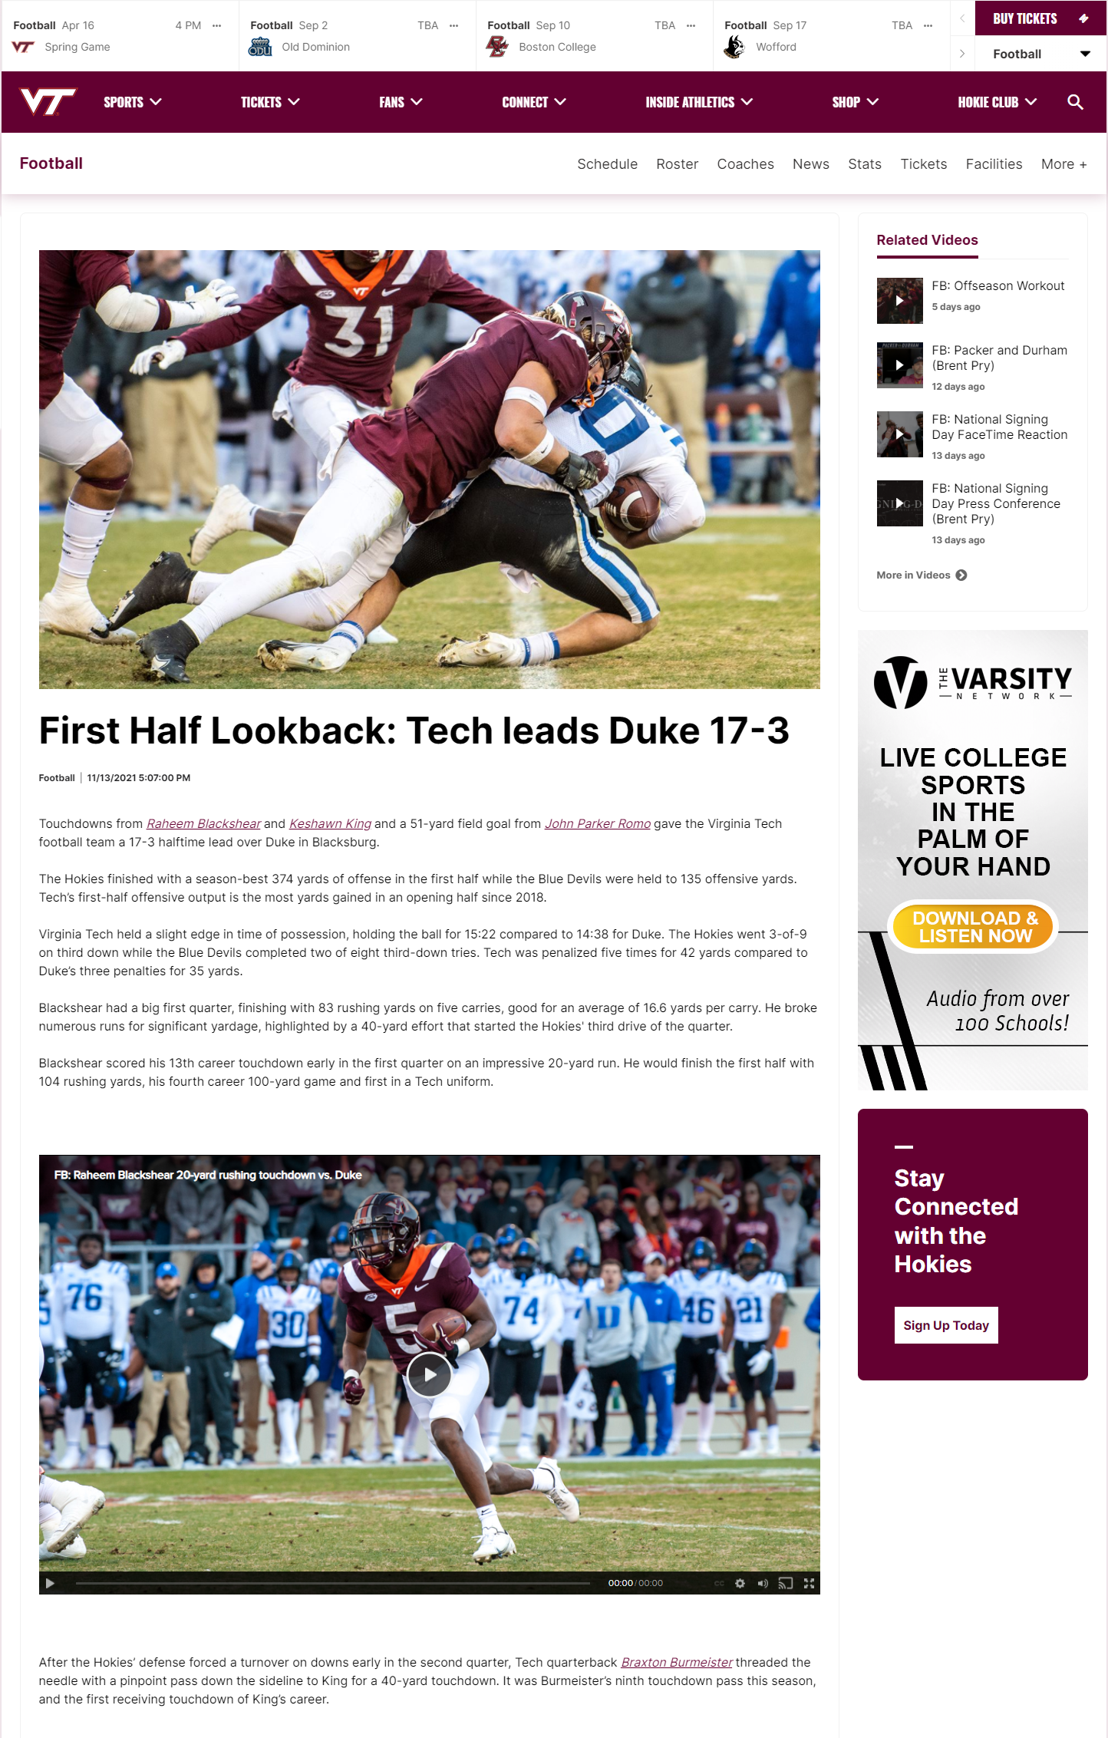
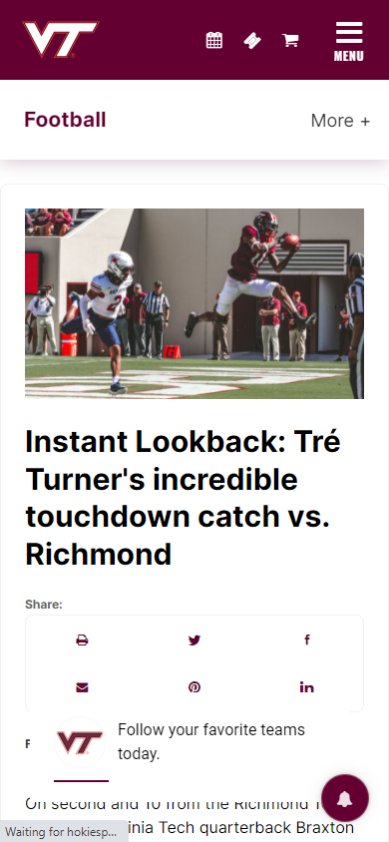
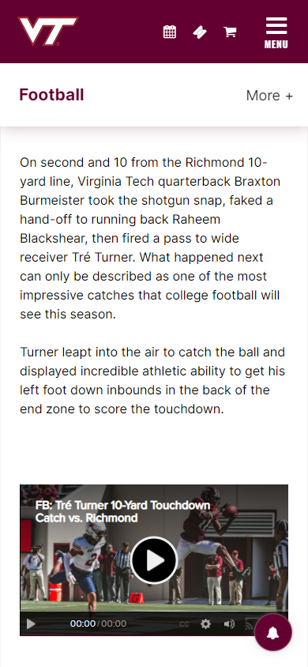
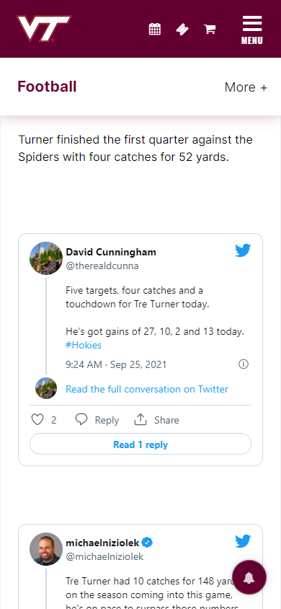
Engaging fans with timely relevant content deepens your relationship
hokiesports.com Google Analytics, September 1, 2021 – February 14, 2022
Notes:
VT had a focus on creating new, creative content for football this year
Why was this a focus coming into the year?
How did lookback content fit into the plan?
What were you hoping fans get out of this content?
What did you see in terms of results?

Slide 34
Lookback content was consumed well by enthusiastic Hokie fans
~40
Stories
141K
Pageviews
3.1K
Avg. Views
51K
Fans
136K Sessions
2.7
Sessions/Fan
hokiesports.com Google Analytics, September 1, 2021 – February 14, 2022
Notes:
Six stories had more than 5K views
4 of the top 10 were women’s basketball
Half were for football
Views of lookback content have increased every month, except December, since starting the effort
Fans are getting familiar with the content and looking for it

Slide 35
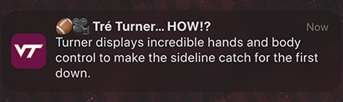
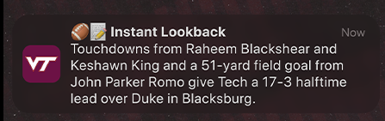
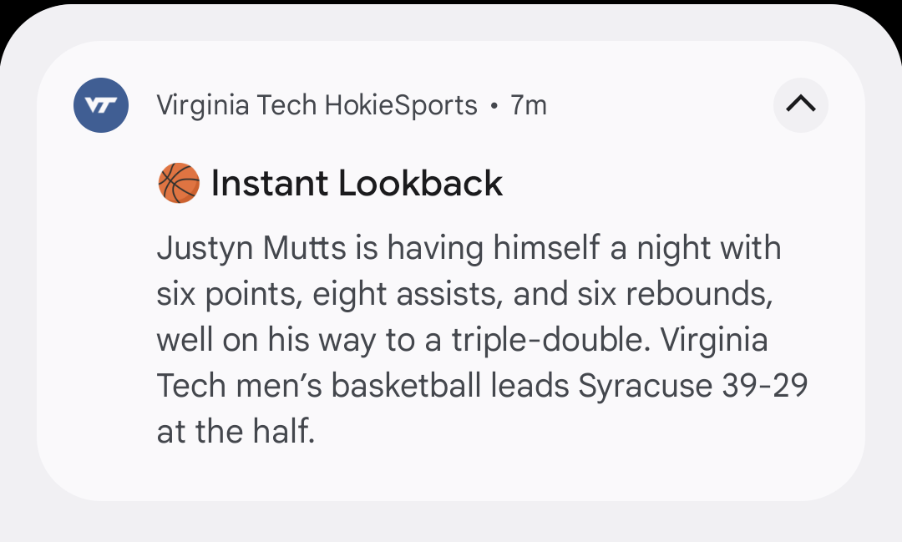
HokieSports Lookback App Notifications
hokiesports.com Google Analytics, September 1, 2021 – February 14, 2022
Notes:
VT’s notifications try to have a positive spin no matter the score, provide detail to help a fan know what’s happening in the game, but also interesting enough to entice someone to click in to check out the content

Slide 36
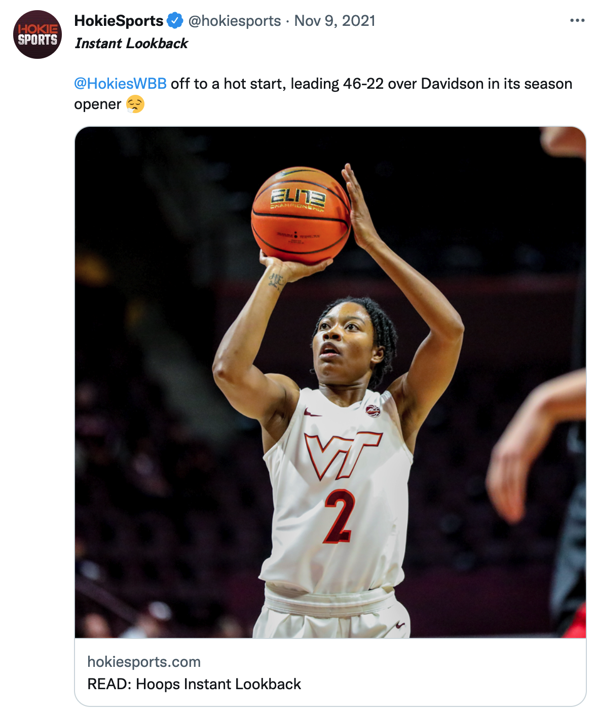
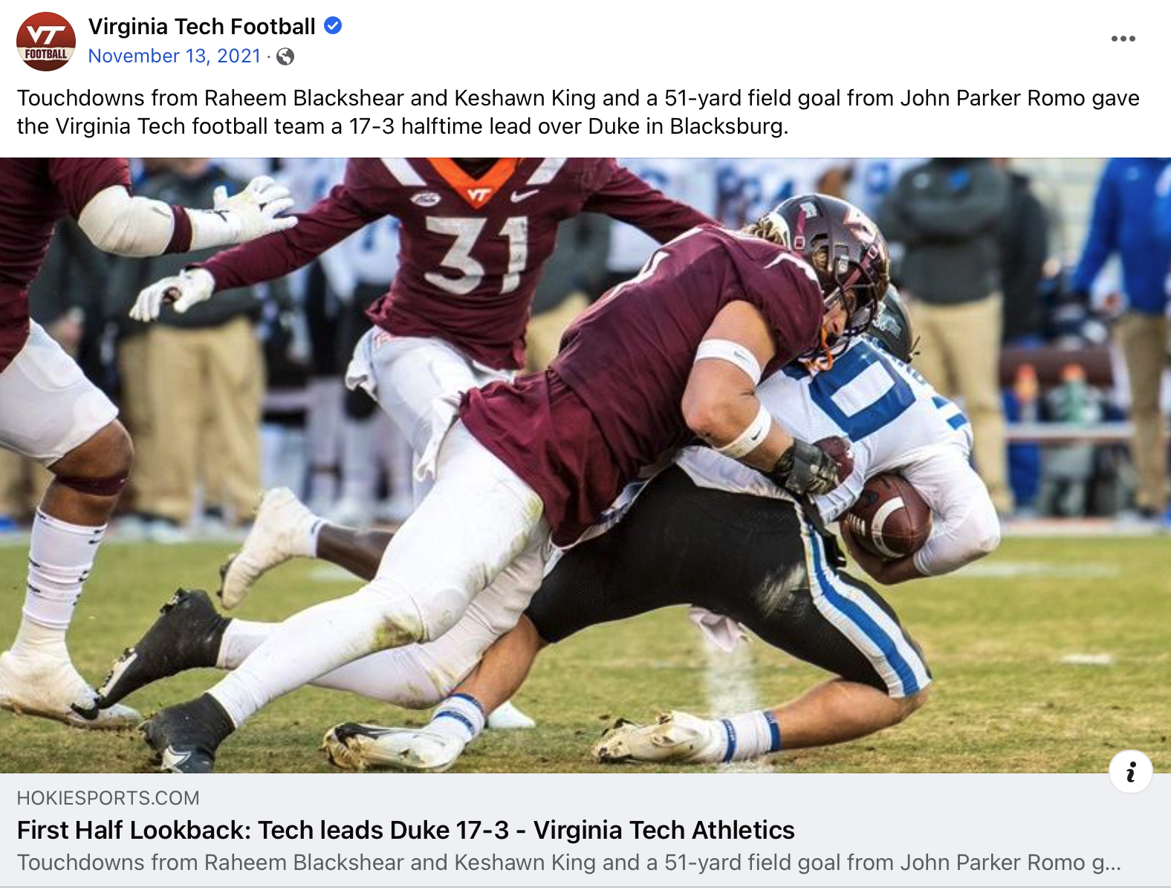
HokieSports Lookback Social Distribution
hokiesports.com Google Analytics, September 1, 2021 – February 14, 2022
Notes:
Social posts generally follow the same format with an engaging tone, and enough detail to entice a click.

Slide 37
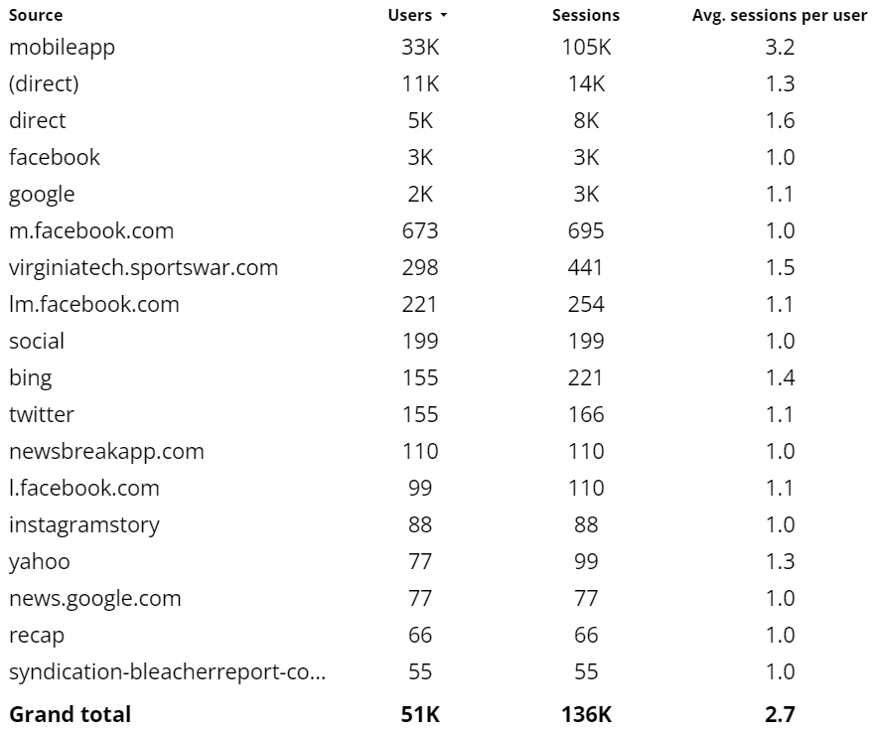
Engaging content can be picked up by other sources for expanded distribution
hokiesports.com Google Analytics, September 1, 2021 – February 14, 2022
Notes:
Most sessions are coming from the app notifications, and with great frequency
But good content will get picked up and distributed by other outlets
Including fans sharing organically on social
Both helps take some of the work off you
Last – we can dive deeper into who is coming from this content, take it to the MMR teams for potential sponsorship

Slide 38
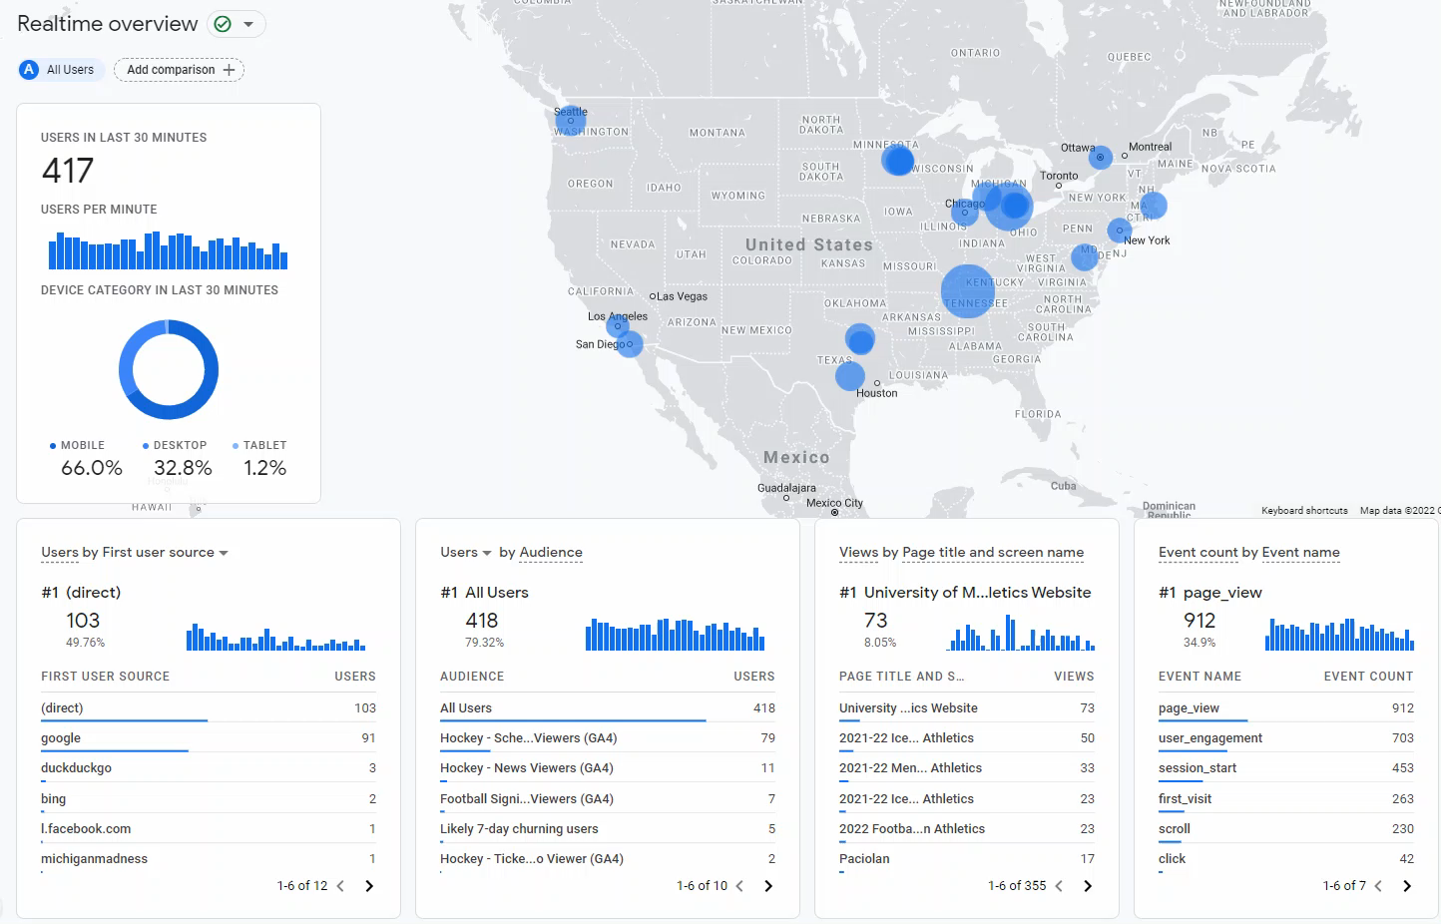
A word on Google Analytics 4
Notes:
Google is pushing GA4 heavily
GA4 is not currently supported on eVenue, but it is in the works
Using GA4 to build remarketing audiences will help get you setup for the future as targeting in the digital landscape evolves.

Slide 39
New Measurement Options in GA4
Engagement Time and Rate
Segment overlap
Churn probability
Conversion probability

Slide 40
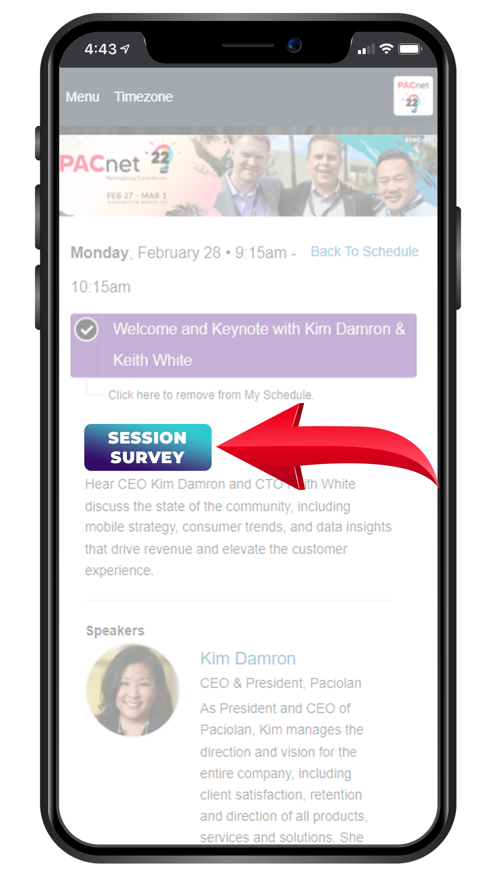
THANK YOU!
QUESTIONS?
Please complete the online session evaluation.

